Slide 1
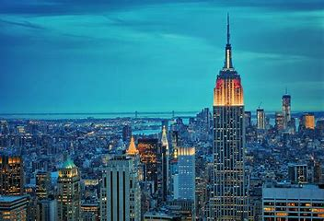



Catalyzing Teams’ Ballgame
Amidst
Large-Scale Enterprise Transformation
NYC
February 6, 2024
Notes:
Good morning. Delighted to be here today. I am Gagan Marwaha from Toronto, Canada. How are you all doing?

Slide 2
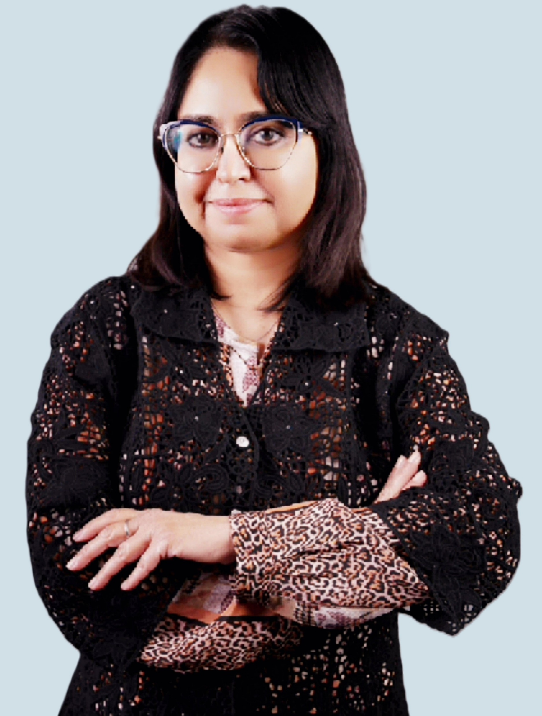











NYC
Scaled Agile Journey Line
2011-
2017
2017
Since
2017
Seasoned Agility Leader, Trainer & Coach
Rich Experience on High-Impact Innovative Products, Solutions & Services
Lifelong Learner, Thriving on Challenges & Influencing Positive Outcomes
Notes:
A bit about my scaled agile journey started organically a decade ago in Financial Services space, when my program at Amex was cherry-picked for piloting SAFe as a poster child for the organization. I immersed in it, growing my competencies and mindset.
I am inspired by compelling stories and will like to share a special one today – a piece of my heart “Catalyzing Teams’ Ballgame Amidst Large-Scale Enterprise Transformation”.
I vividly remember, the year was 2015. At that time, I was working with Global Lending Products portfolio and the company was in the middle of a Global Enterprise Transformation.
I was particularly intrigued by the newly-minted, multi-faceted RTE role. I joined the bandwagon to get the ball rolling as a newbie SAFe RTE on my very first ART …

Slide 3
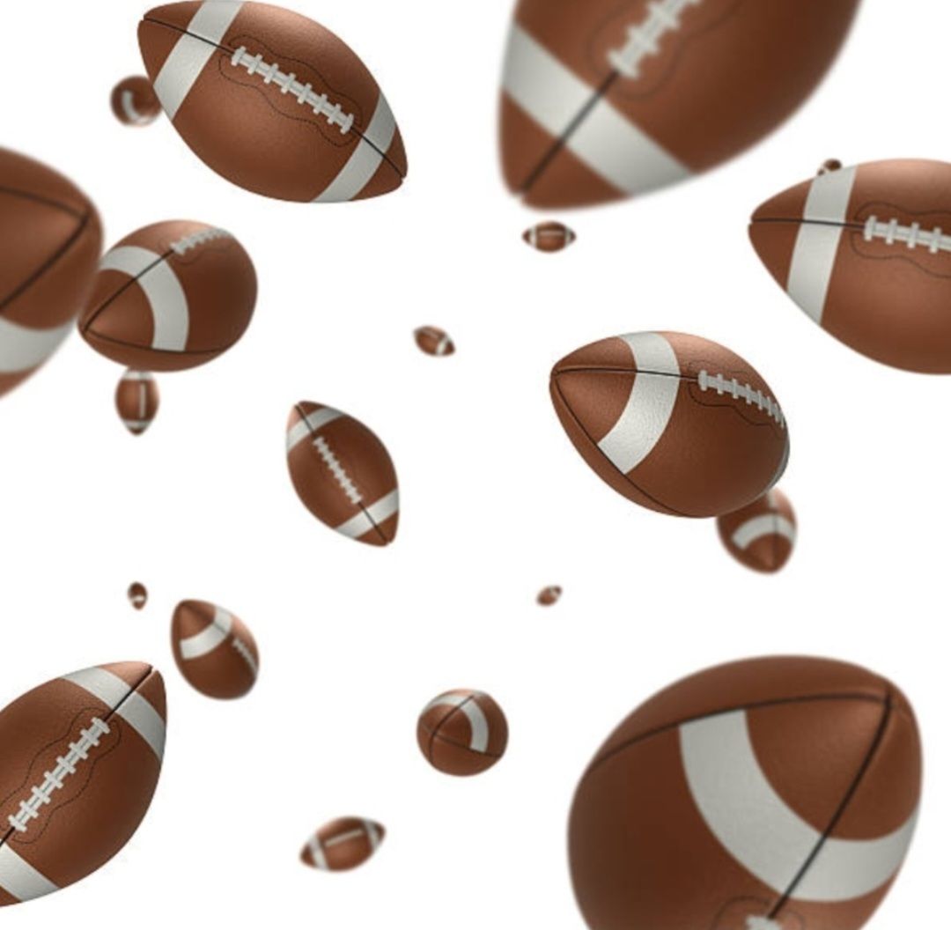
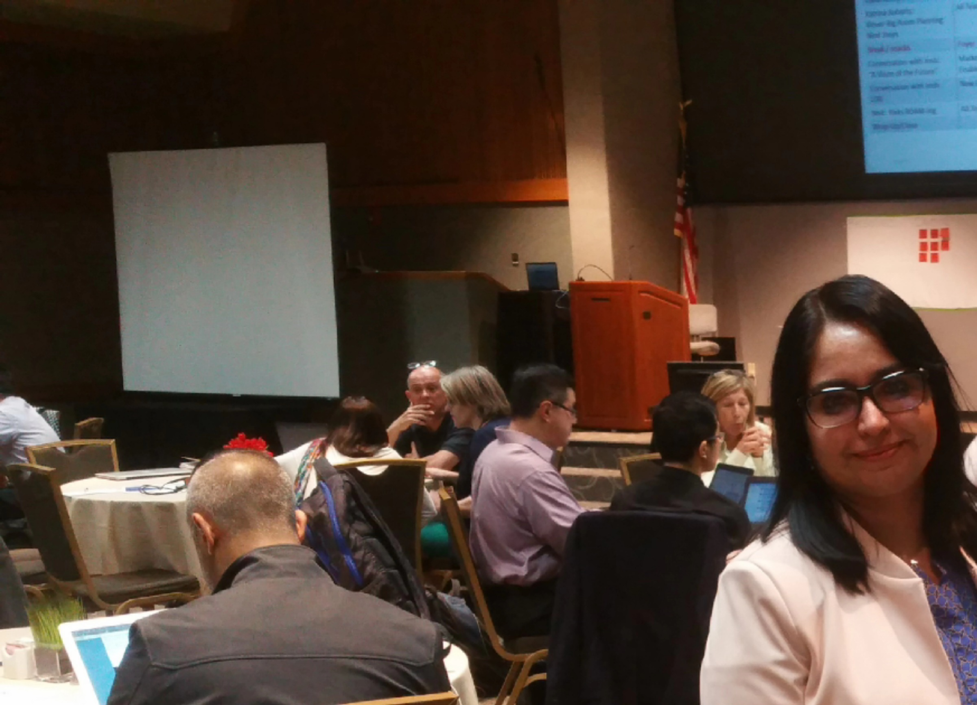
NYC
RTE SUMMIT NYC
Slippery GROUND
Notes:
After the initial euphoria, the ground begun to feel shaky. Looked like a storm was brewing up around me with so many balls up in the air. There was ongoing upheaval with restructuring, role changes, new practices, direction change on products strategy, inertia and paradigm shifts all the time throughout the organization as it was reinventing itself. I had learnt the art and science of enabling the teams on a SAFe ART well, but amidst many more layers with all this perennial Volatility, Uncertainty, Complexity and Ambiguity, my dilemma was: how could I ground and sustain the spirit of the Agile teams on my ART and help elevate their game and keep them in a generative space?
I was at cross-roads. This was a defining moment and with a leap of faith, I got on this quest to find out ways of elevating teams amidst this curve ball.

Slide 4
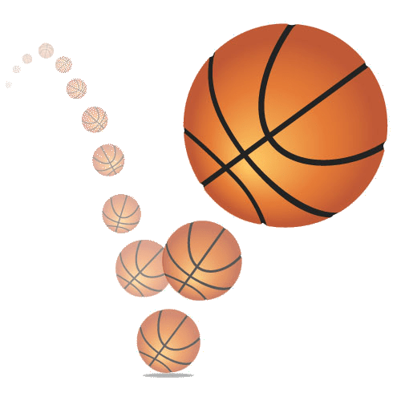

NYC
Bouncing BALL
RTE SUMMIT NYC
* Inspired by Drexler-Sibbet High Performing Teams
Notes:
I was looking for the eye in the storm – the sweet spot, the space & associated conditions for my teams to be able to innovate and be impactful.
I discovered about the energy arch for sustained teams growth, visualized as a bouncing ball:
If the ball is dropped without energy, it will bounce effortlessly and rolls aside.
The ball initially bounces off the “ground” of current realities, regaining freedom of movement through mastery of the constraints.
If energy is invested correctly in the beginning to set movement the ball will keep its dynamic, it can reach great heights.
Based on Law of Physics + Neuro-science.
I reckoned that tapping into energy field for the ART teams may be an opportunity with raw potential for high ART performance. Only that the ball was bouncing up and down all the time. Immersed myself in experiments. Let me deep-dive into some of the pragmatic approaches and tools that I leveraged additionally to invigorate the ART performance amidst the shifting sands. These complement SAFe tools and approaches seamlessly.

Slide 5
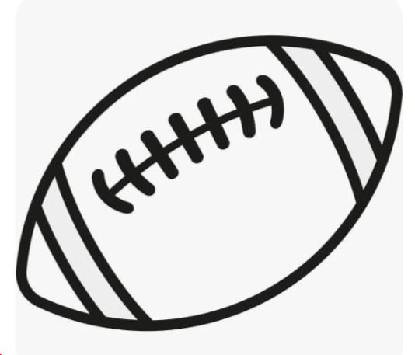
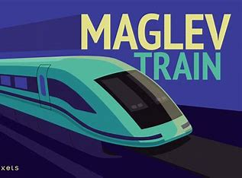

Season1: Home
Trust
NYC
RTE SUMMIT 2024
NYC
Invoking Collective Identity:
Creating Teams Cohesion:
Train Analogy for the ART
2. Logos/Names for ART Teams
Respected
Red Hot
Proven
Magic
Powerful
Stable
Sleek
Nimble
Cutting Edge
Notes:
Starting with building a strong foundation and anchor for trust through visualization for the ART and ART team(s), as the ART is being kicked off (before 1st PI). Agile Team Logos with “Train” metaphor and team names/logos identified by teams themselves based on Train attributes.
Interesting things begin to surface within the teams. Two of the teams – Magic & Powerful, were facing some integrated solution challenges with the complexity of software being developed and they were beginning to get disheartened. During my alignment session with the teams, suddenly, one team member said, Yes – we have a challenge, but we have the Power of Magic and we can do it, Instantly, the energy shifted and the teams started brainstorming on what all is possible and they came up with a creative resolution. This was huge. At that time, I knew that this energy game was beginning to work! Every word has the ability to manifest its spirit!

Slide 6

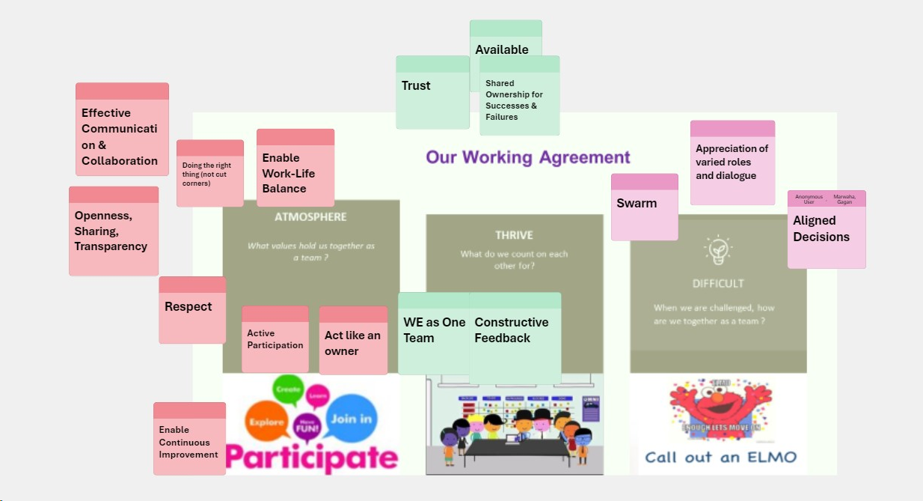
NYC
RTE SUMMIT 2024
NYC
Season2: PLAYING FIELD
Alignment
Robust ART Working Agreement:
Atmosphere: What values hold us together ?
Thrive: What do we count on each other for ?
Difficult: When challenged, how will we be together ?
Notes:
Building/Regularly refreshing Working Agreements at ART and Team levels, holding one another accountable

Slide 7
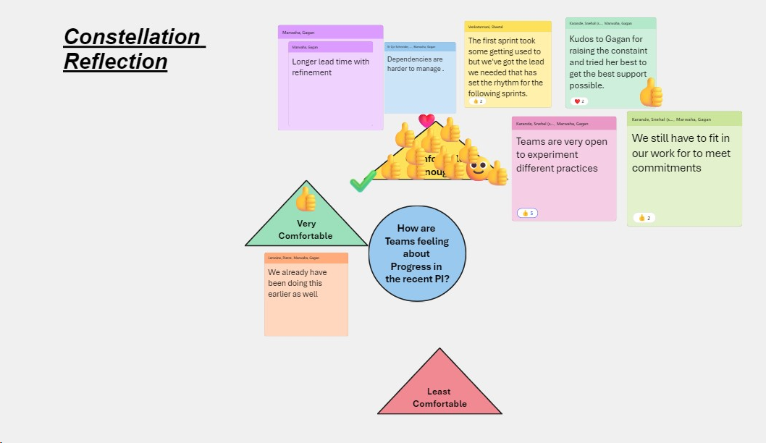
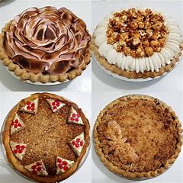
NYC
RTE SUMMIT 2024
NYC
Season2: PLAYING FIELD
Alignment (continued)
Ongoing Pulse Checks:
0
1. Sensing through Constellation
2. P.I.E.S. Just-in-time Teams Check-Ins
Notes:
Sensing the energy levels through regular teams PIES Check-ins and ART Constellation every PI, surfacing questions like: How are you feeling about a particular aspect during the recent PI – with concrete adaptive Action(s) via Lunch & Learns, Workshops, coaching, mentoring etc. It became a game of pies among the ART teams

Slide 8
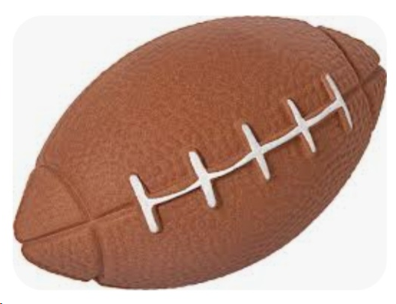
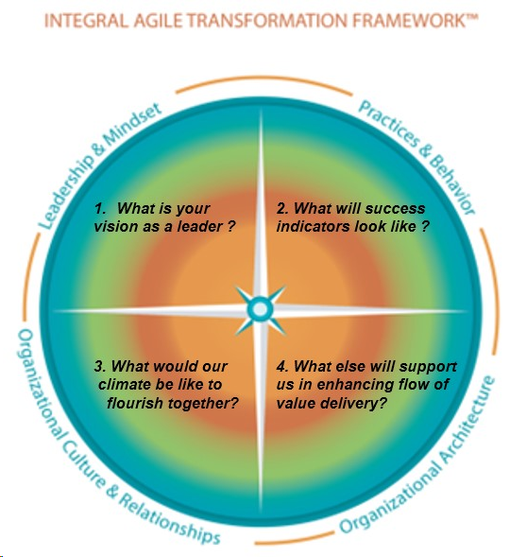
NYC
RTE SUMMIT 2024
NYC
Season3: Breaking NEW Grounds
Co-Create
Integrated Perspectives : Tapping into the Eco-Systems
SAFE Space
Empower ART Teams
Best Place to Work
Retain Top Talent
ART as ONE Team
Sustainable End-to-End Delivery
Partner with Business Owners
Aligned Roadmap
Represents Business Owner Inputs
Represents ART Executive Inputs
Notes:
Enlarging the positive energy bubble by tapping into the ecosystem: extending to ART Executives, Business Owners, Stakeholders for Integrated perspectives via 1-on-1’s , focussed sessions or combination throughout PI
Through bi-weekly Lean Coffee sessions – Participants propose and discuss theme-based topics with concrete action(s) and champions to Raise Awareness and Relentless Improvements

Slide 9

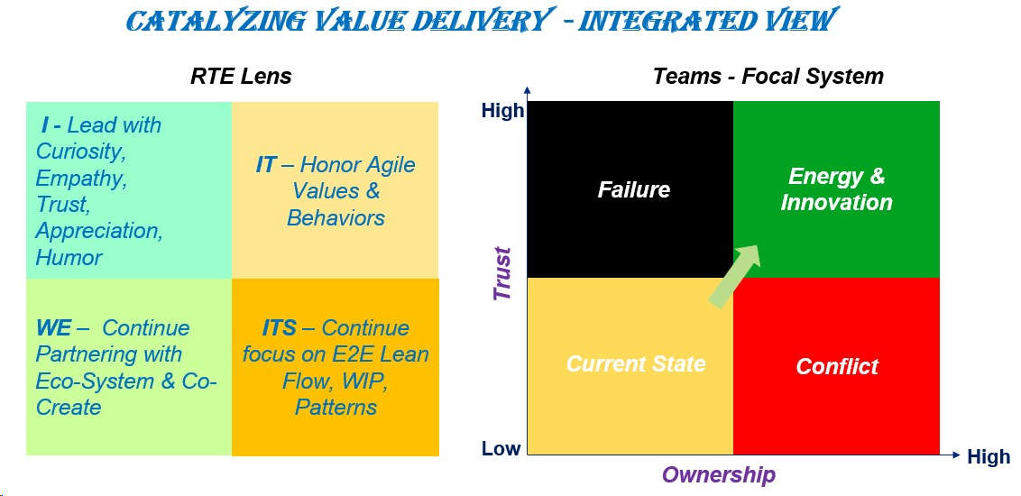
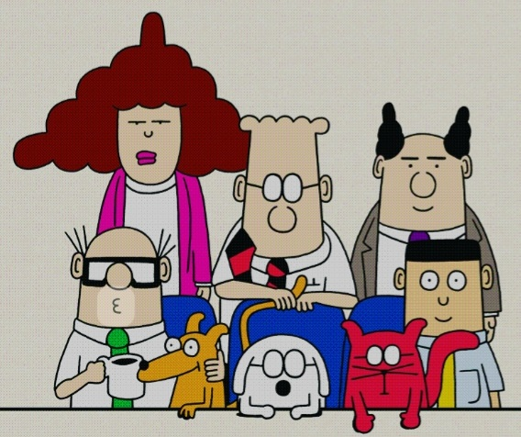

NYC
RTE SUMMIT 2024
NYC
Next Season: NFL
Infinite Game
Notes:
I had a growing realization that this is an infinite energy game and as an RTE, the ball is in my court. I have the prerogative to carry the ball. It is equally important to regularly reflect on the RTE lens and remain on top of the bigger game. And I have been reinventing myself through my experiences and epiphanies, while championing and empowering the game change.
Drip-feed: Small-Subtle-Simple-Superior
Examples:
Inculcating Humor on the ART leveraging Dilbert, Comic Agile cartoons over ART Chat
Appreciating teams on a daily basis
Integrated Calendar with Business owners to bring the ART closer together each PI

Slide 10
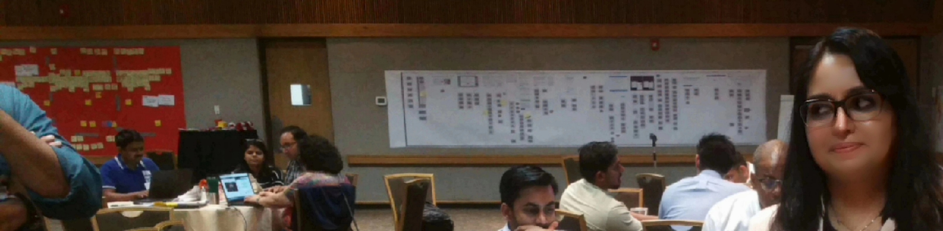
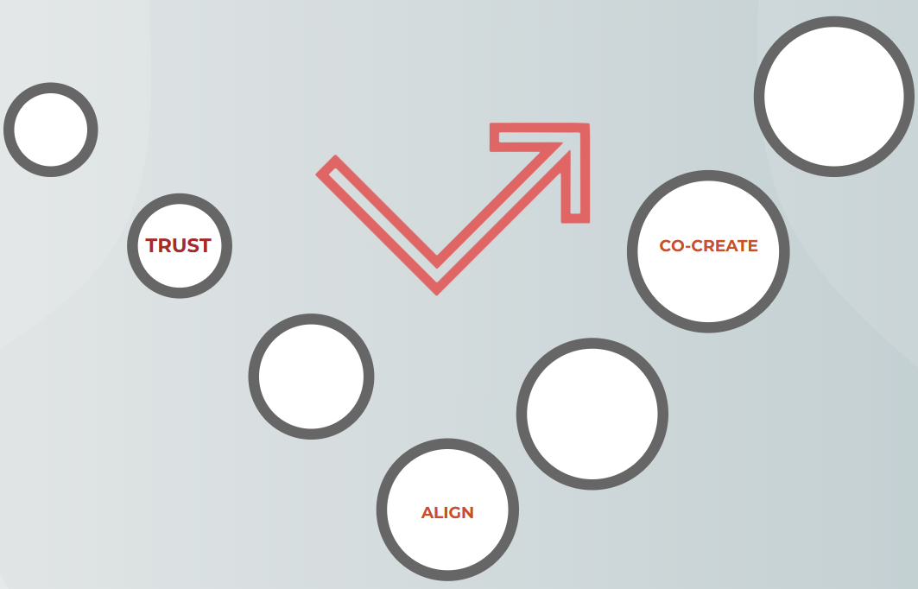
NYC
High-Impact MAGLEV Train
RTE SUMMIT NYC
Game-Changing Products
Multiple Global Markets
Re-inventing Industry Trends
* Inspired by Drexler-Sibbet High Performing Teams
Notes:
I had the honor to serve the Maglev ART for over 2 years and this ART delivered a wide array of innovative, game-changing, trendsetting products in multiple global markets during this tenure, while being in the middle of Large Enterprise Transformation. And I am inspired by the unstoppable spirit of the teams, defying all odds and continue elevating their game to achieve unprecedented outcomes …

Slide 11
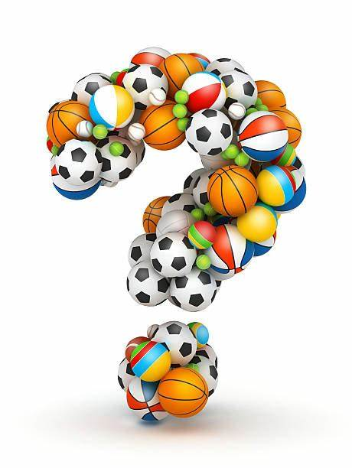
NYC
Notes:
Good morning. Delighted to be here today. I am Gagan Marwaha from Toronto, Canada. How are you all doing?

Slide 12
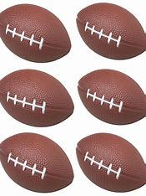

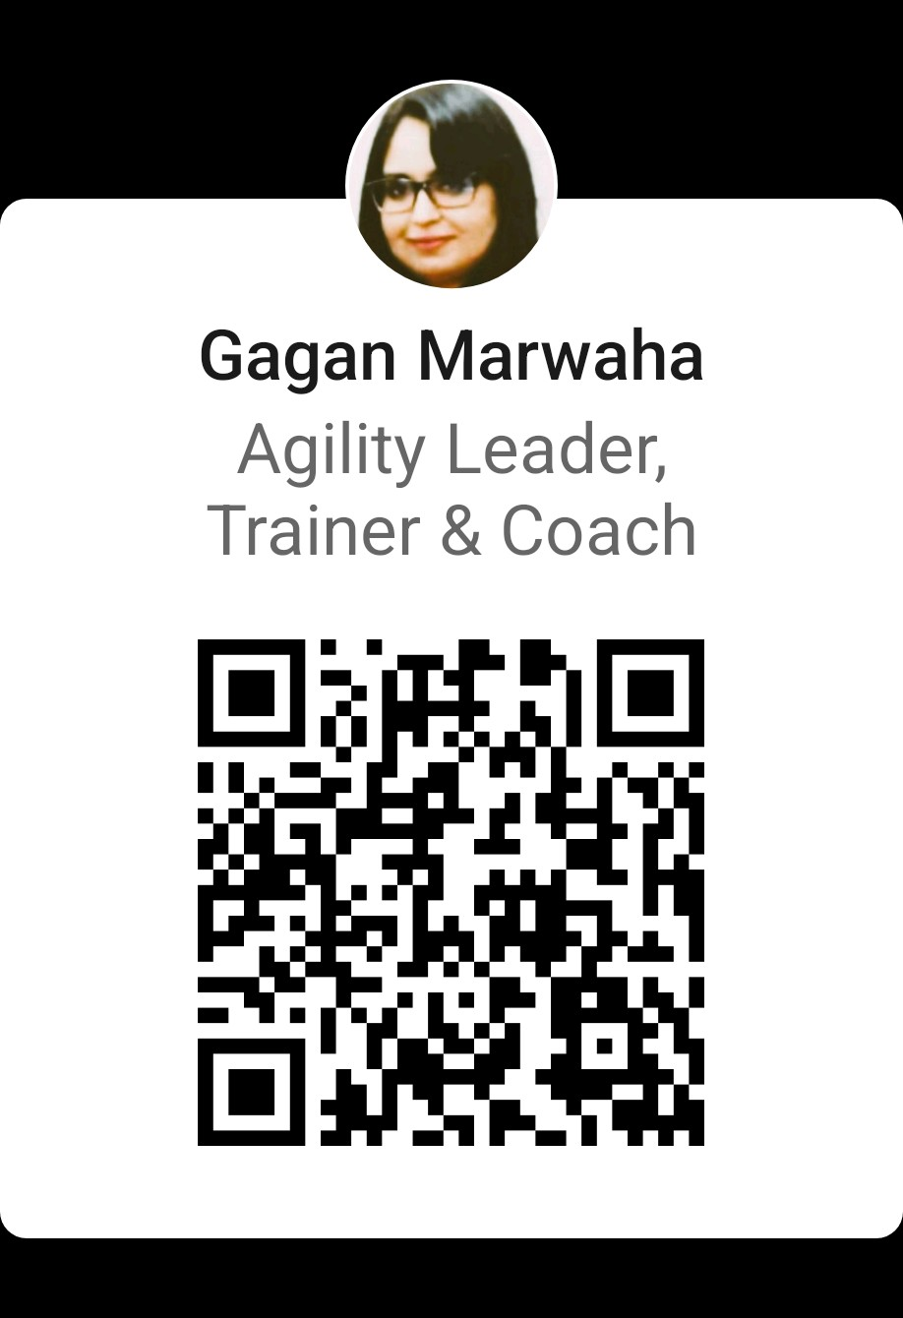
@LinkedIn:
NYC
RTE SUMMIT 2024
NYC
Thank You
Notes:
Welcome questions and invite you to stay connected with me. Thank you.

Slide 13
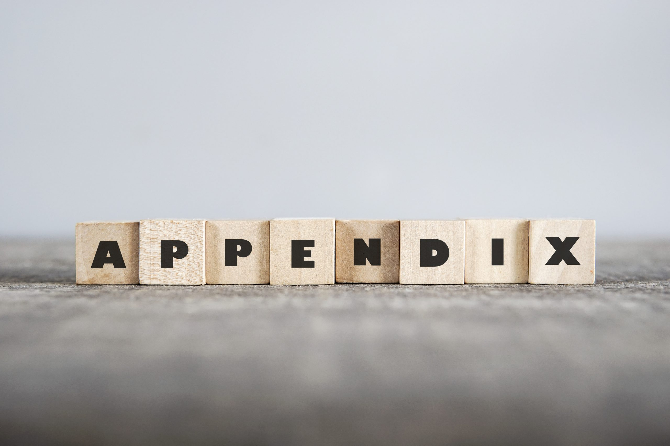
NYC
Notes:
Good morning. Delighted to be here today. I am Gagan Marwaha from Toronto, Canada. How are you all doing?

Slide 14
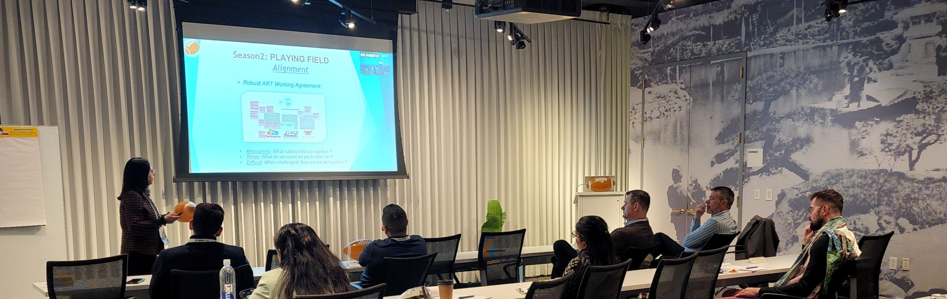
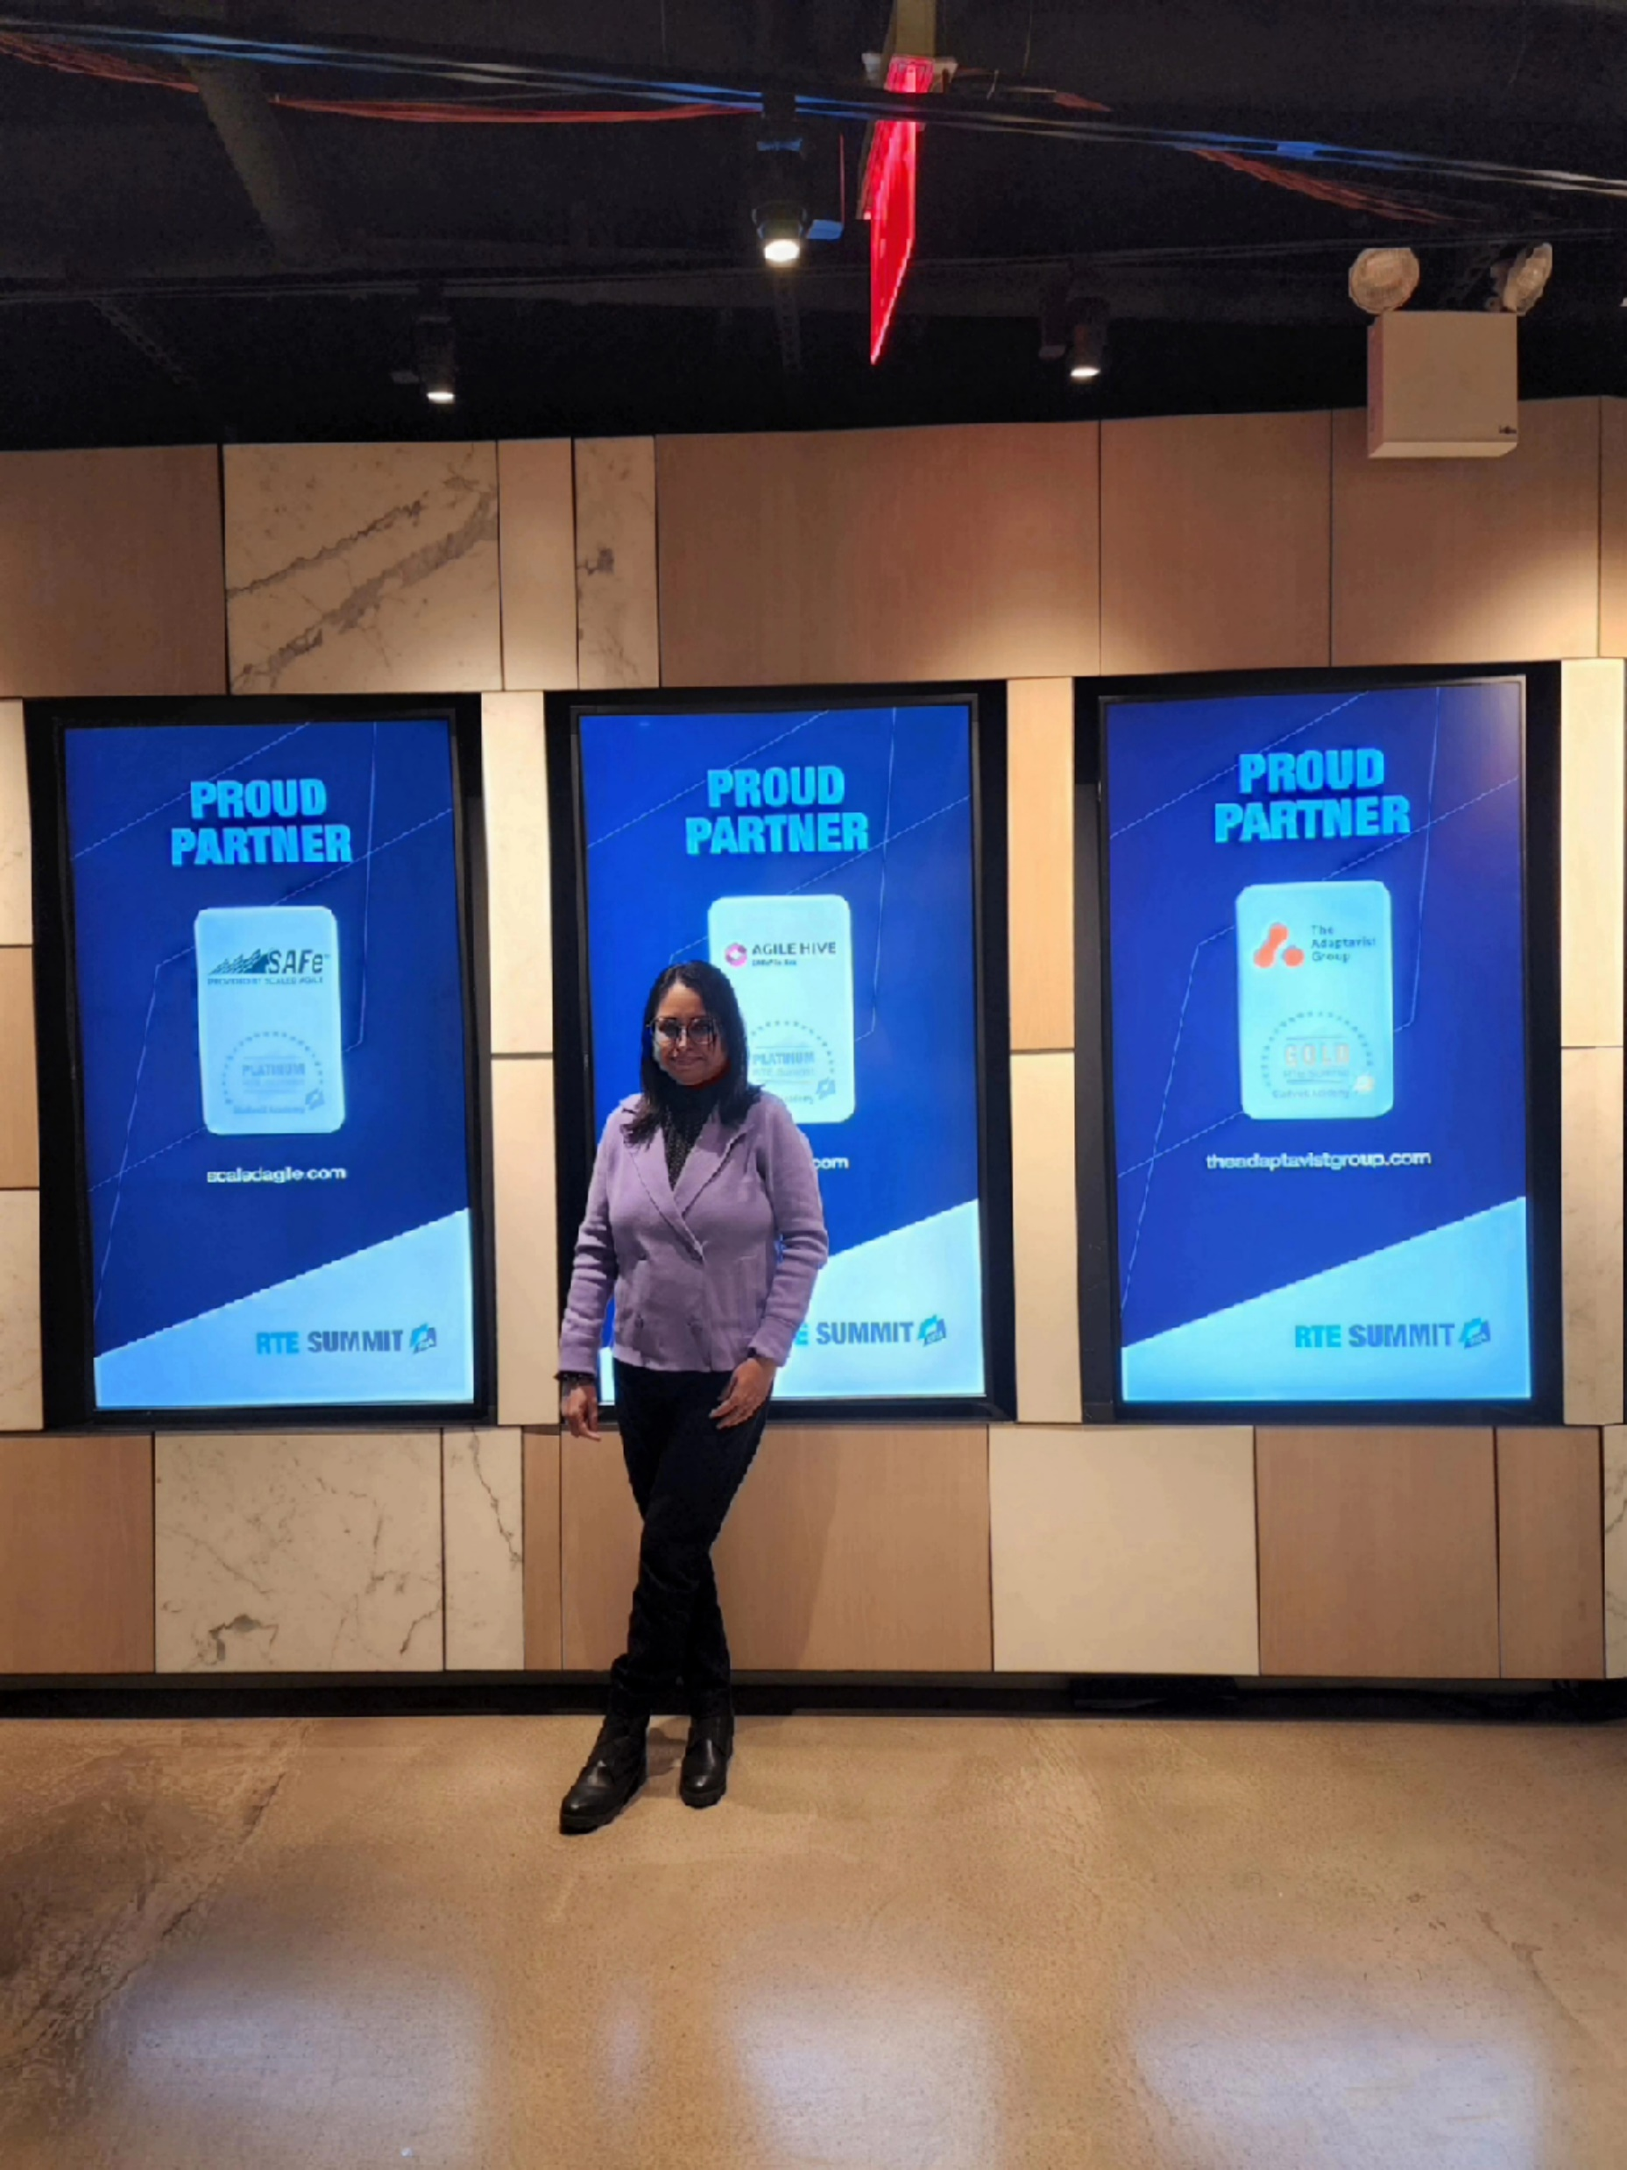
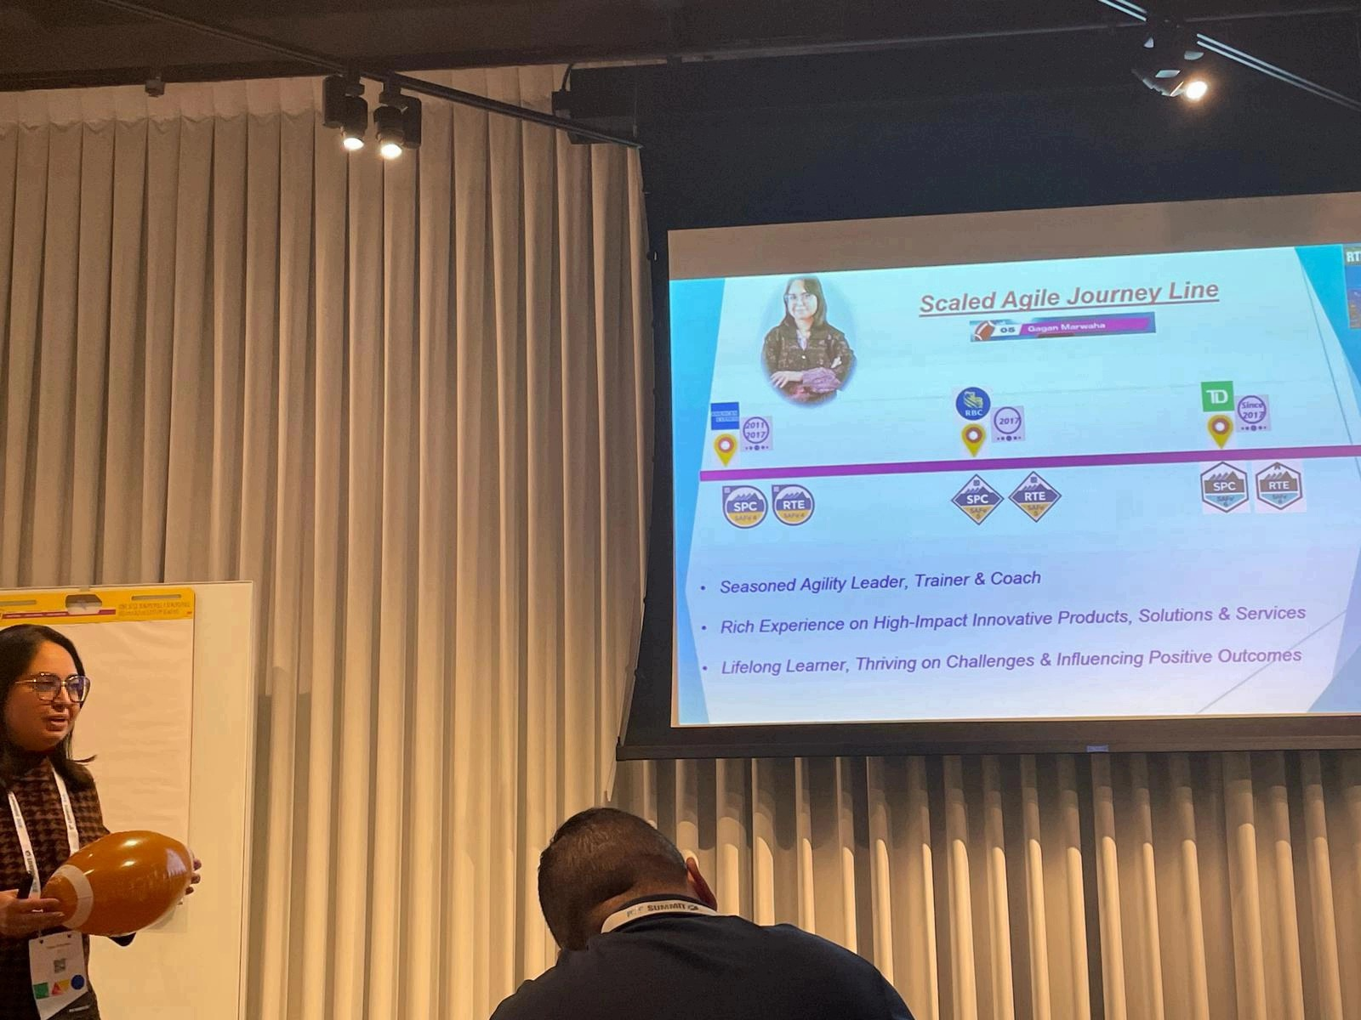
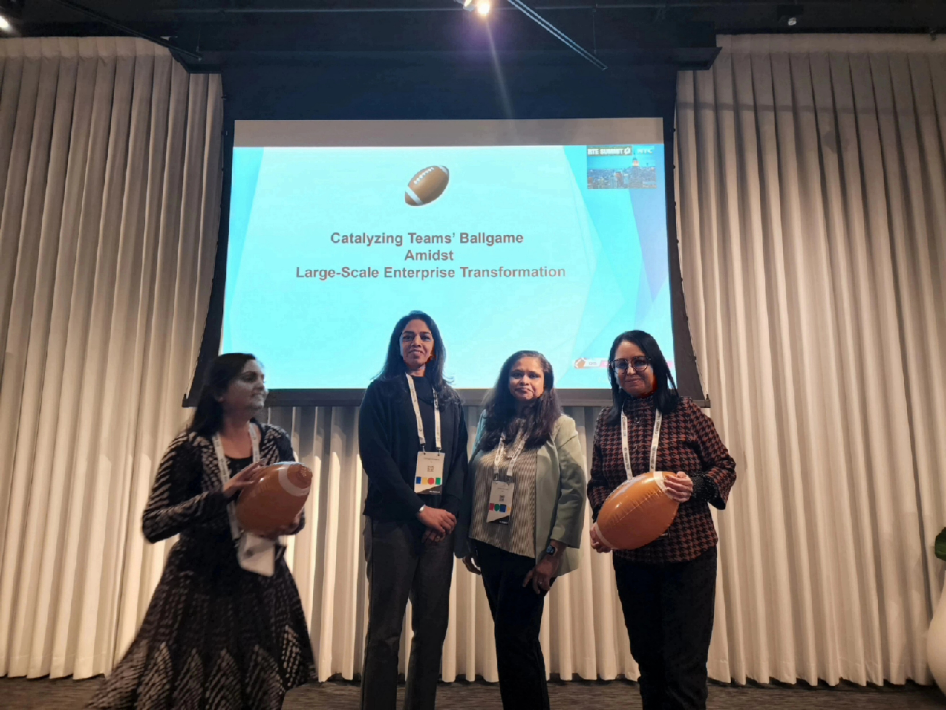
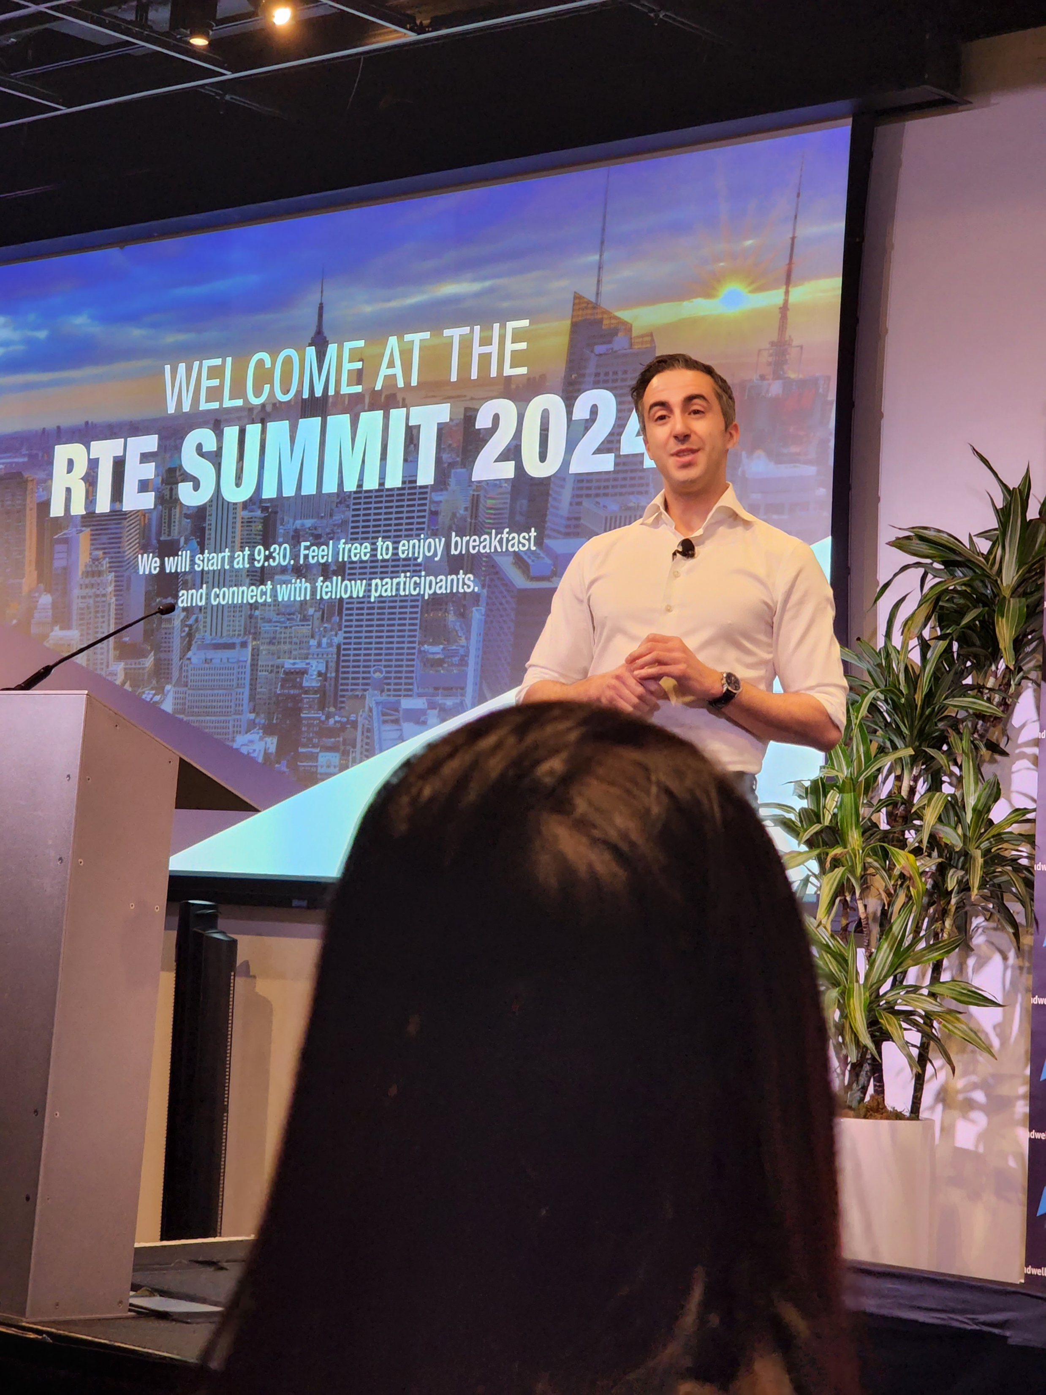
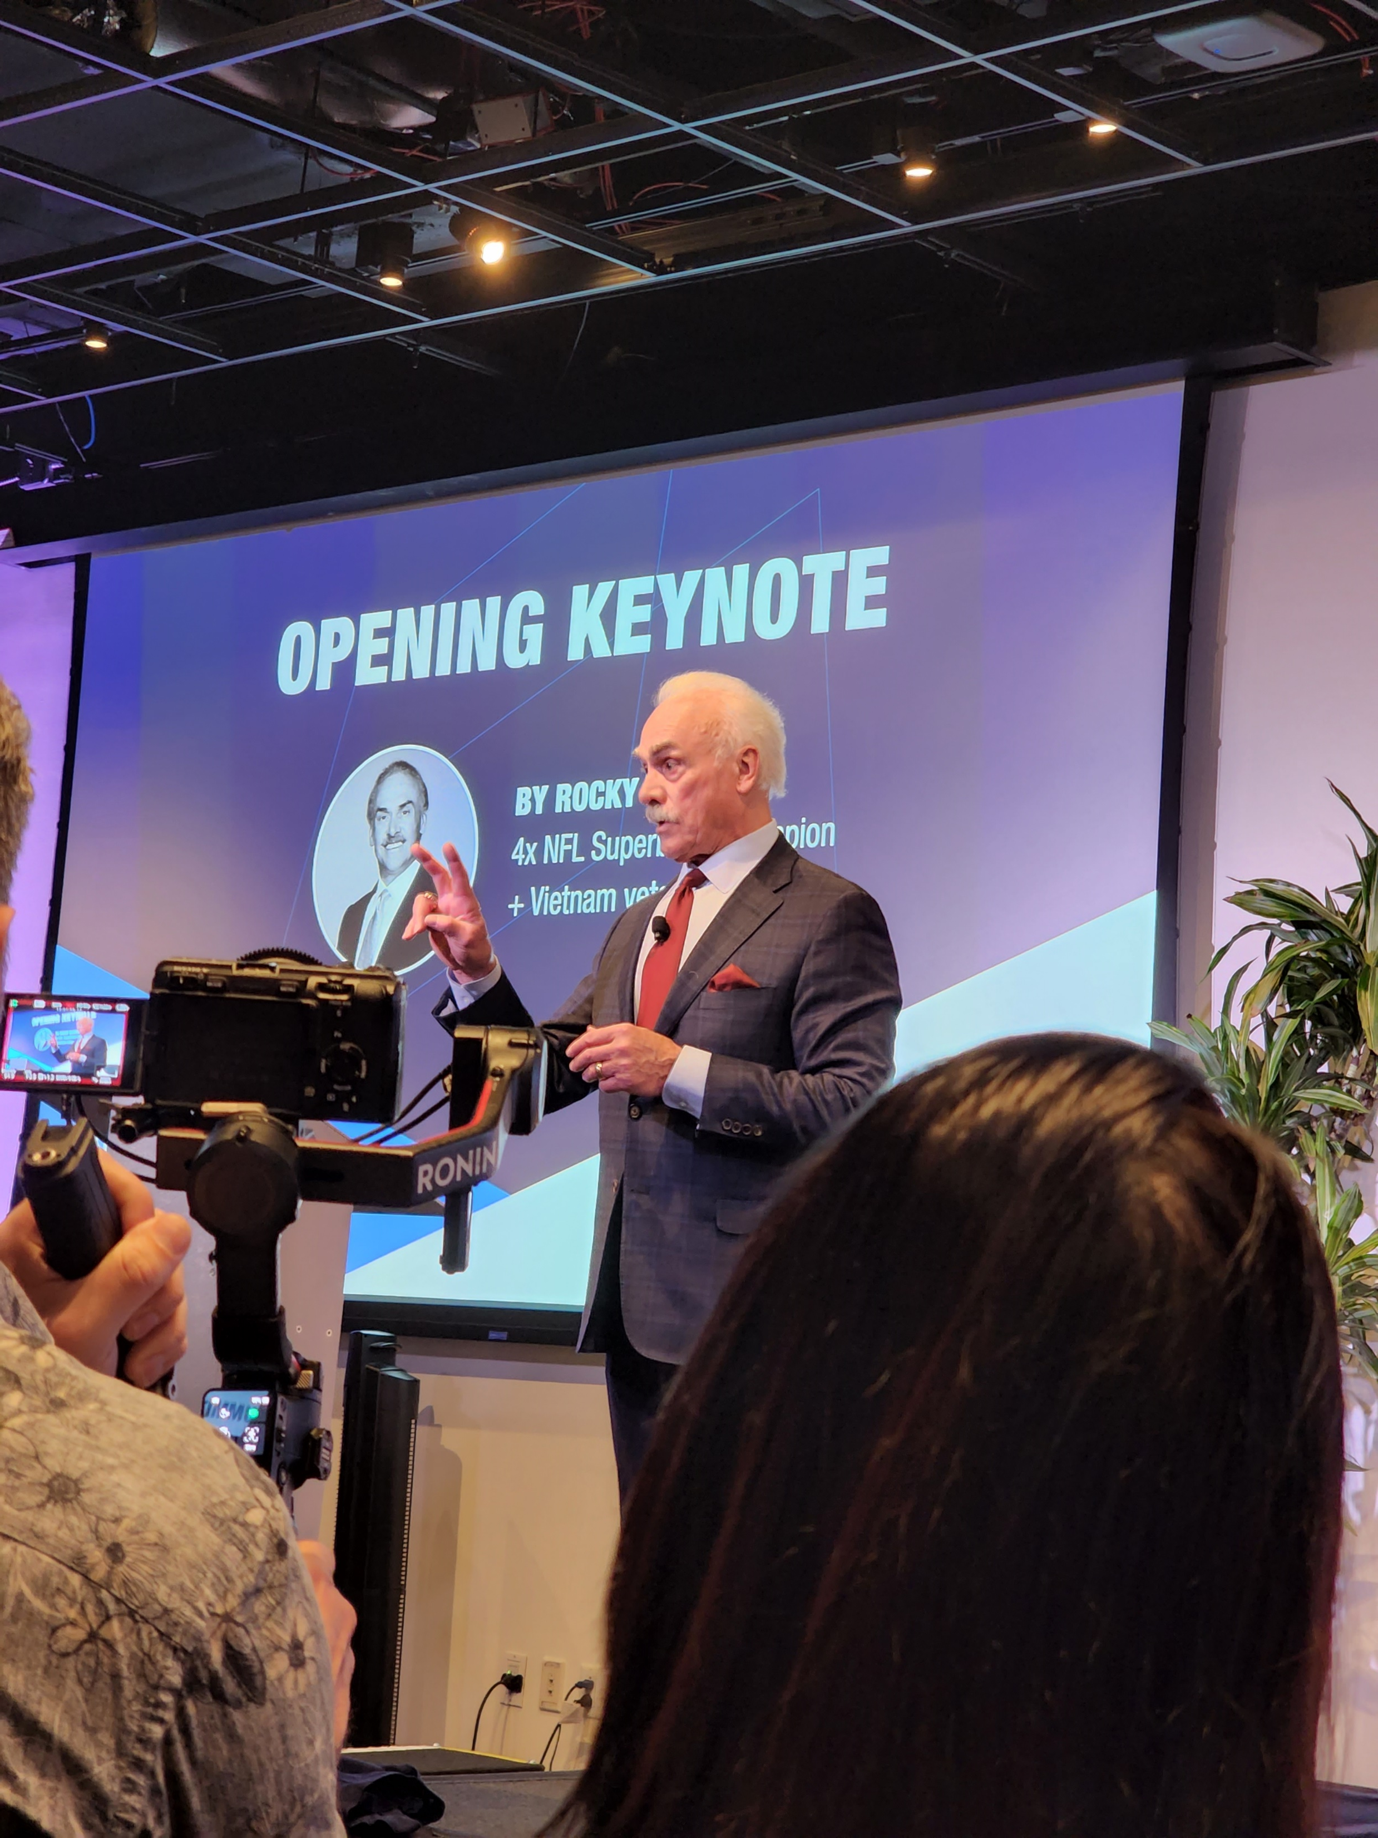
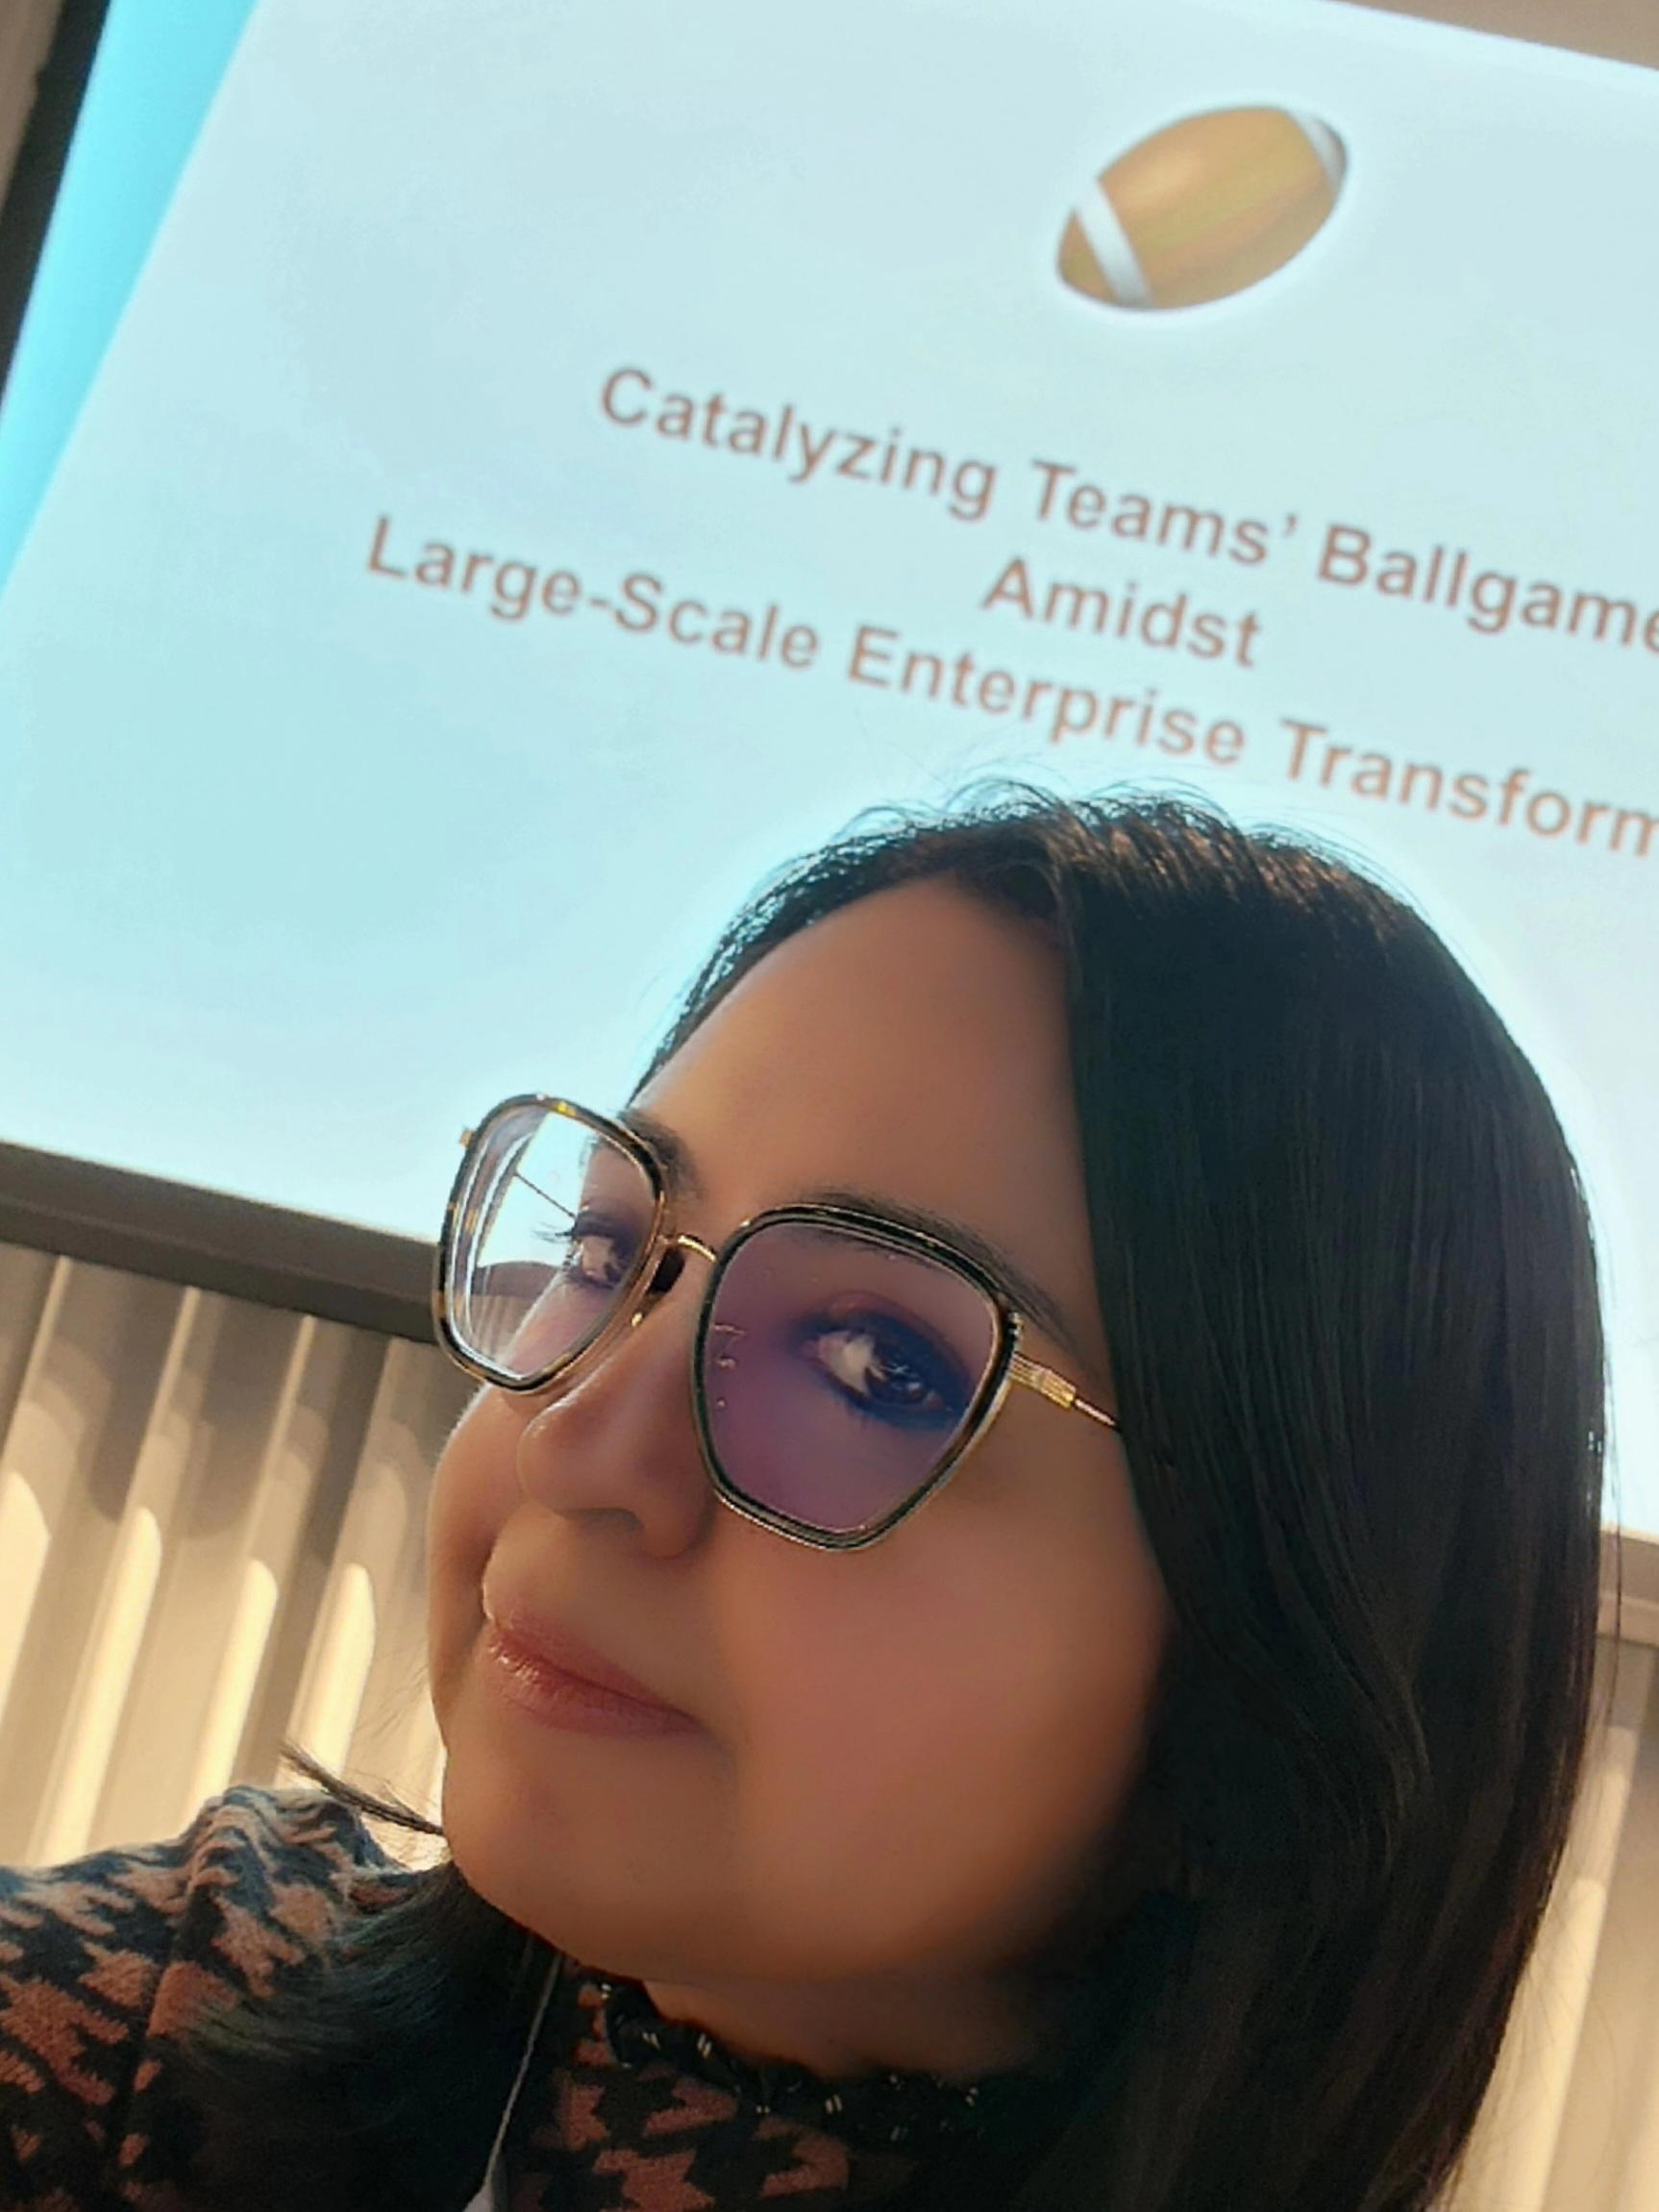
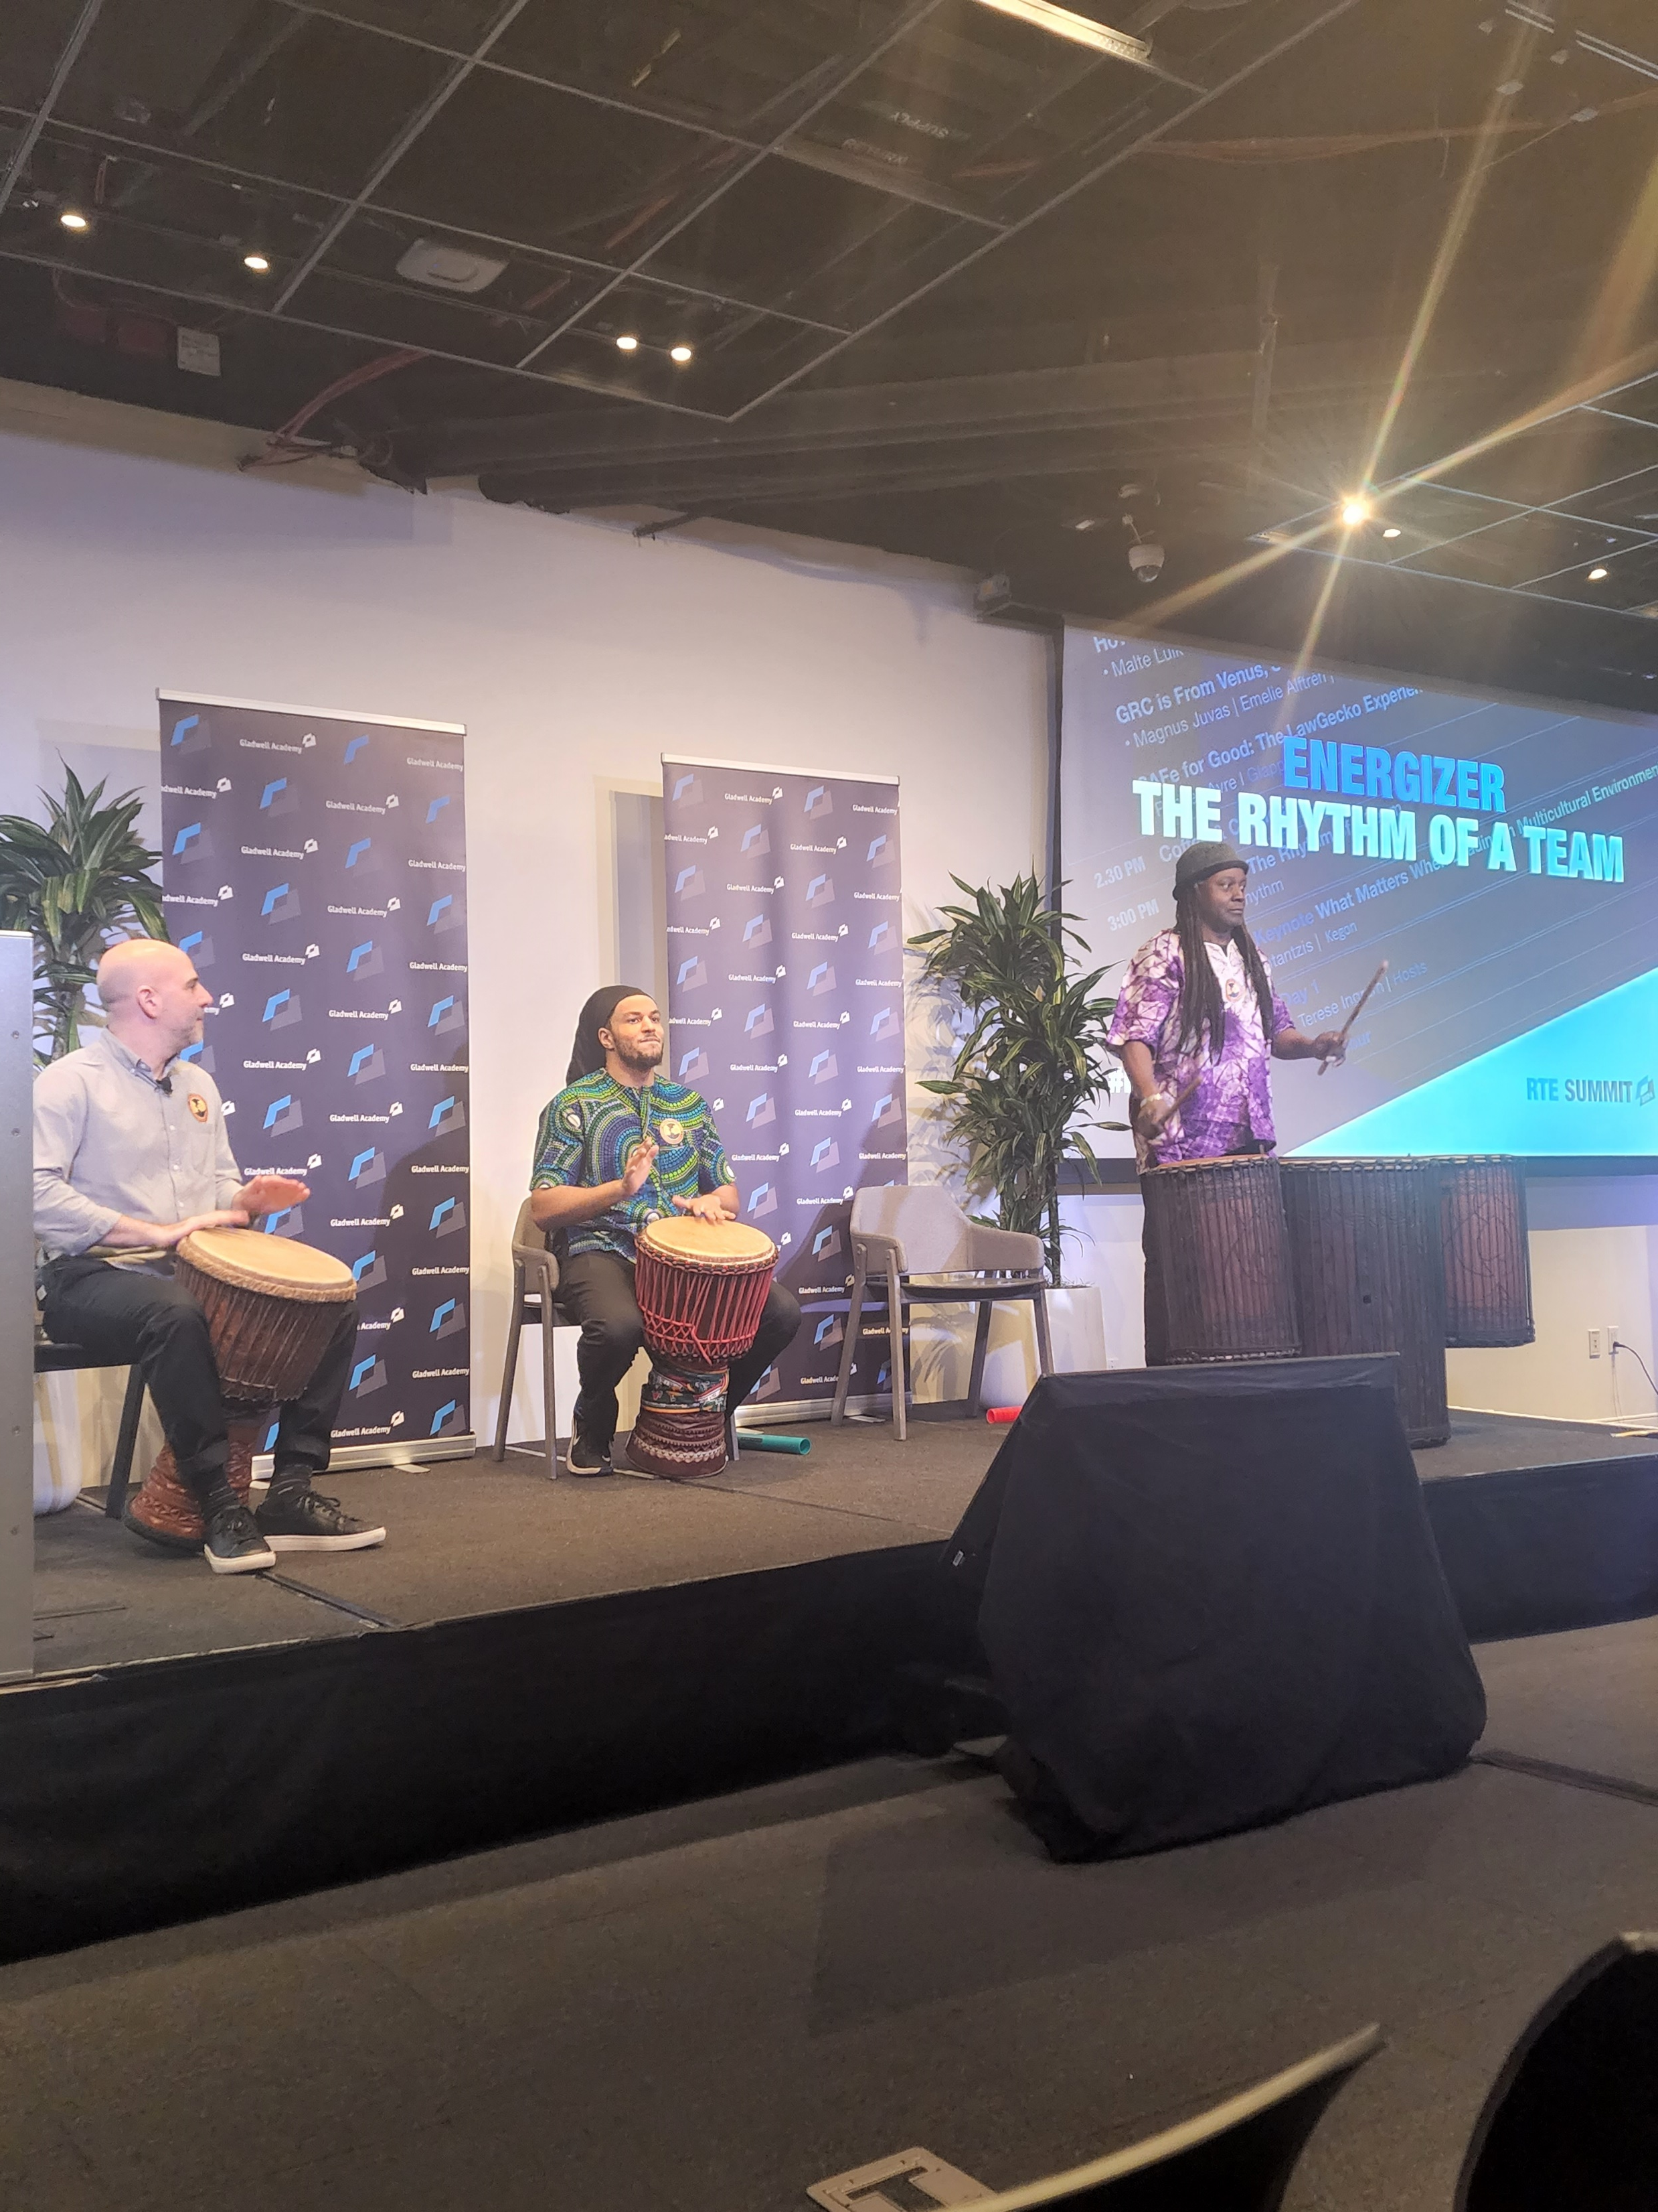
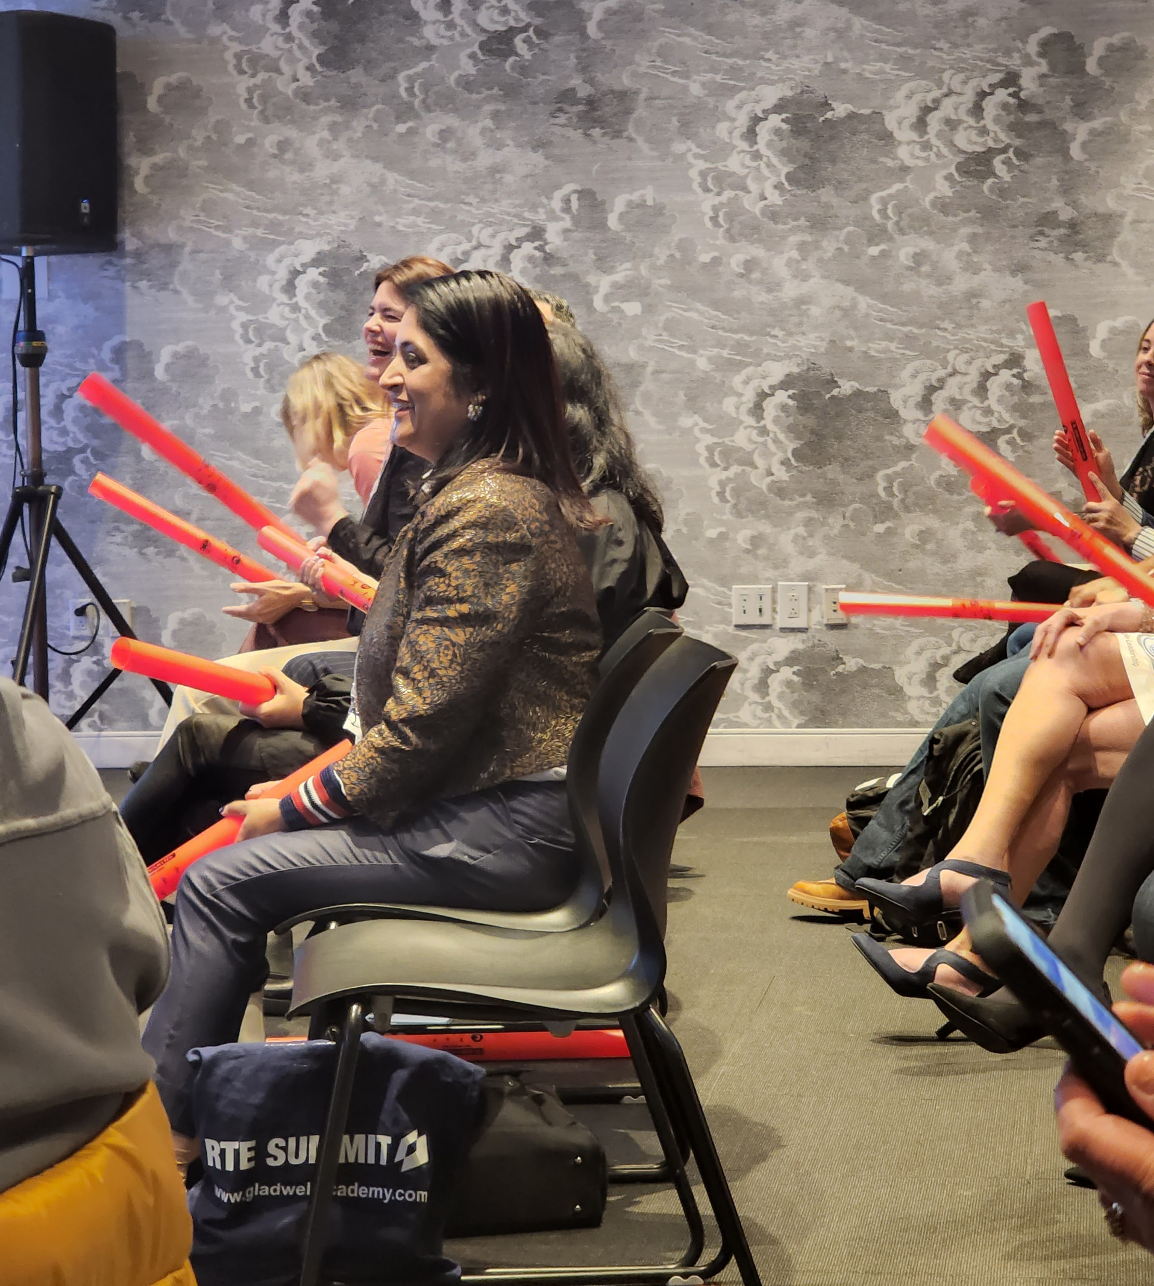
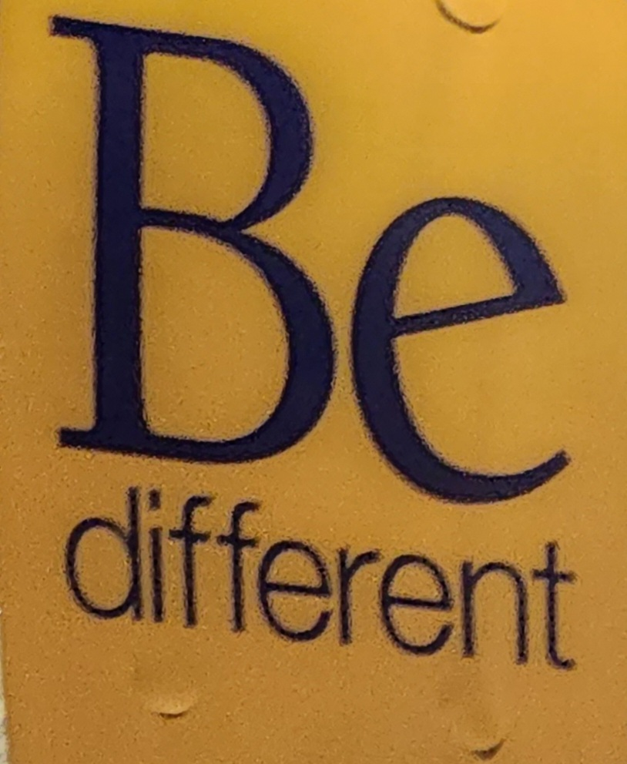
A Ball of a Time!
Notes:
Collage

Slide 15


NYC
RTE SUMMIT 2024
NYC
The full speaker line-up for the RTE Summit NYC (youtube.com)
RTE Summit NYC aftermovie (youtube.com)

