Slide 1


An Impactful Transformation Journey
Gagan Marwaha

Slide 2

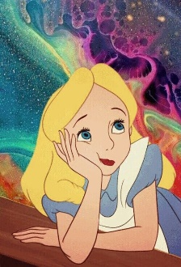
Alice through the Forest Seasons

Slide 3
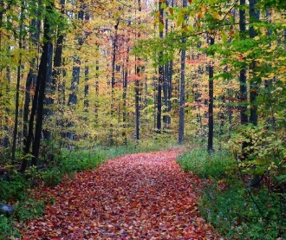
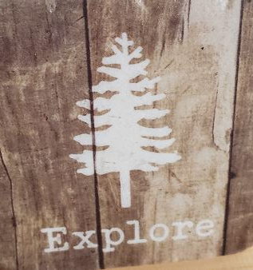
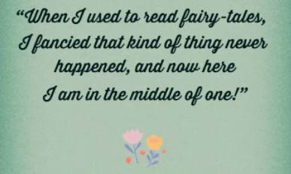
Season 1: Home Turf

Slide 4
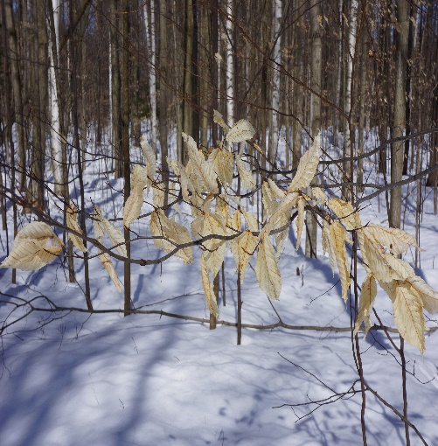

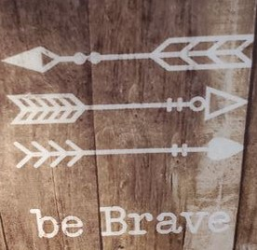
Season 2: FORK in THE WAY

Slide 5

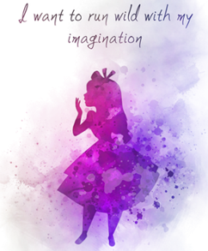
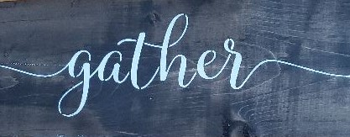
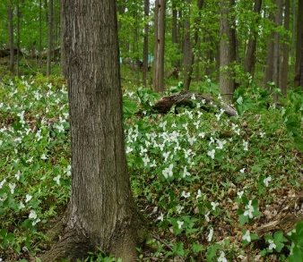
Season 3: Blossoms ON THE PATH

Slide 6
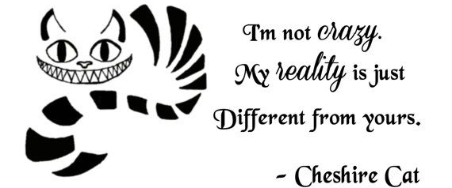
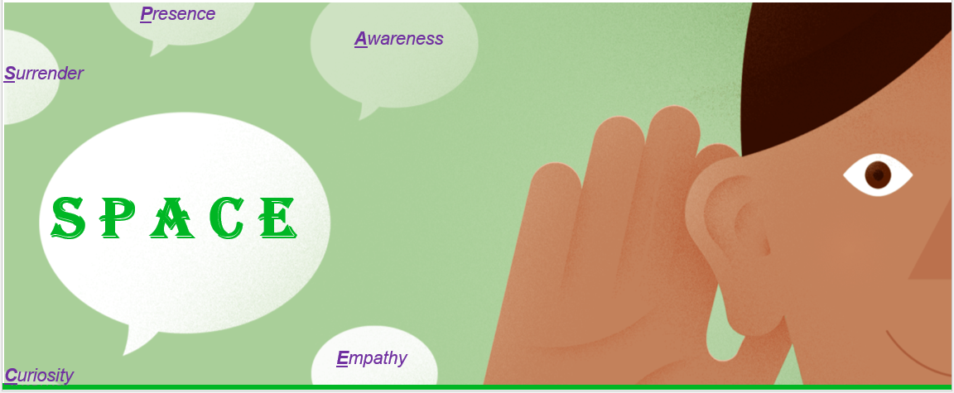
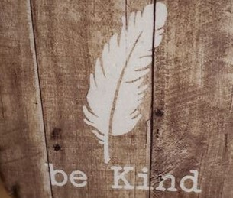
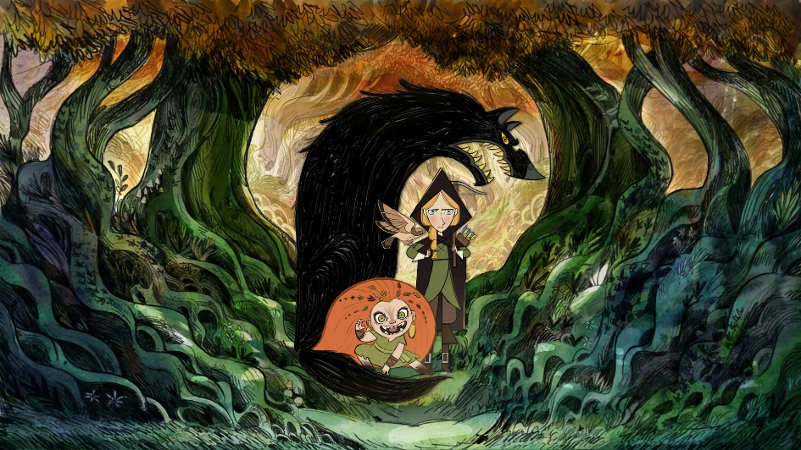
Season 4: conscious nurturing

Slide 7
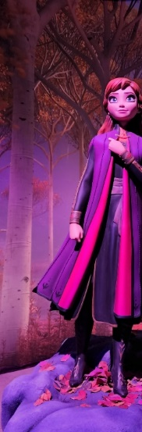

This Season: catalyze impact
Her Magical Journey Continues …

Slide 8
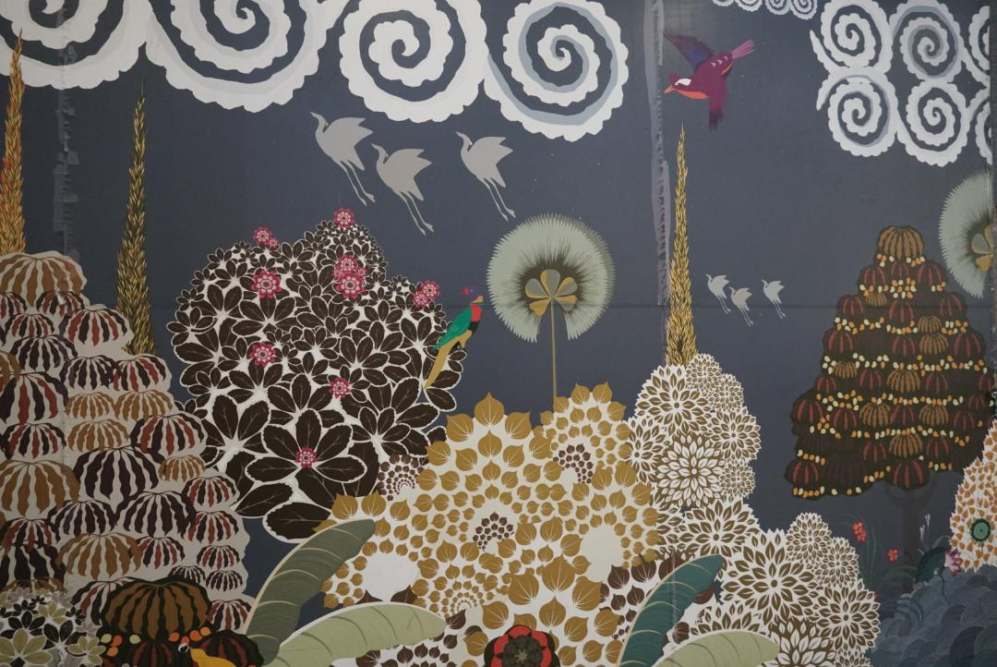

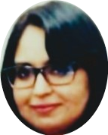
And Here’s Alice …
And This is My Adventure with Agility …
THANK YOU!

Slide 9
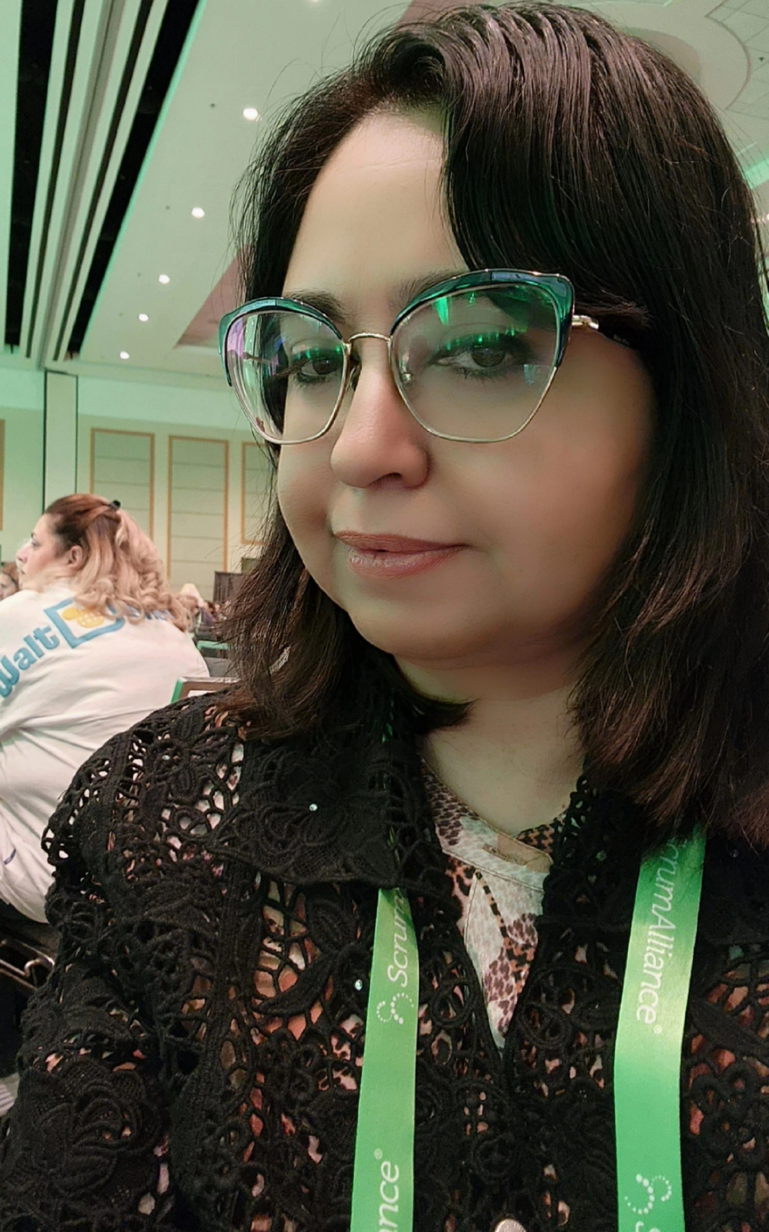
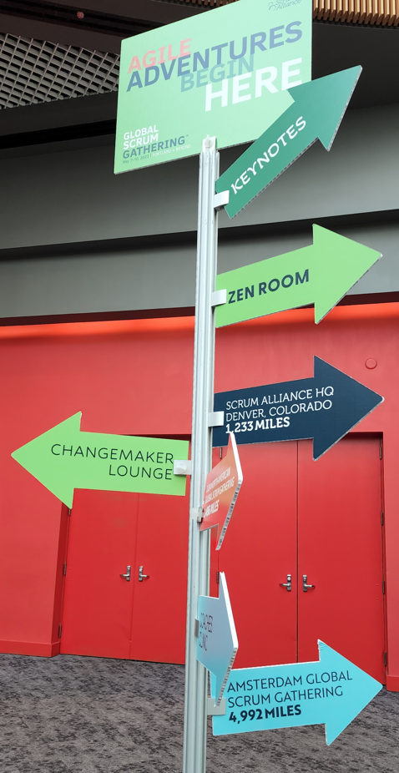
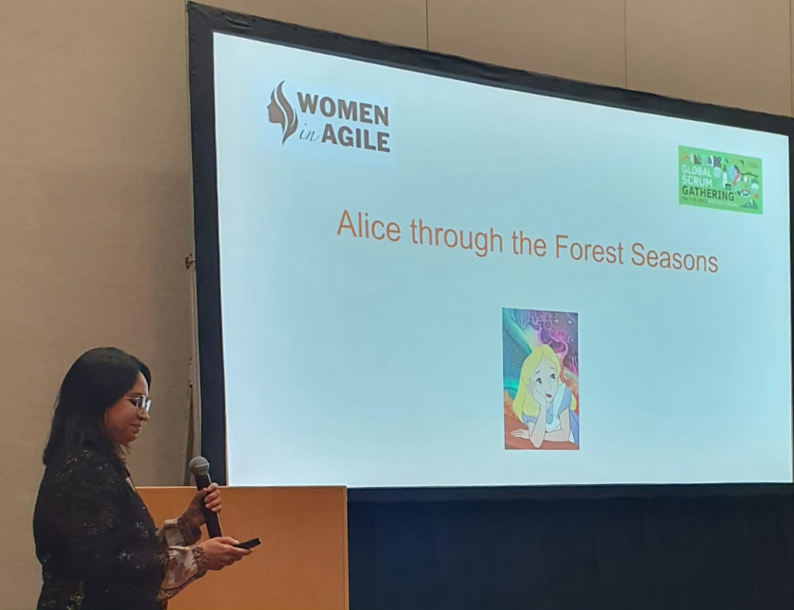

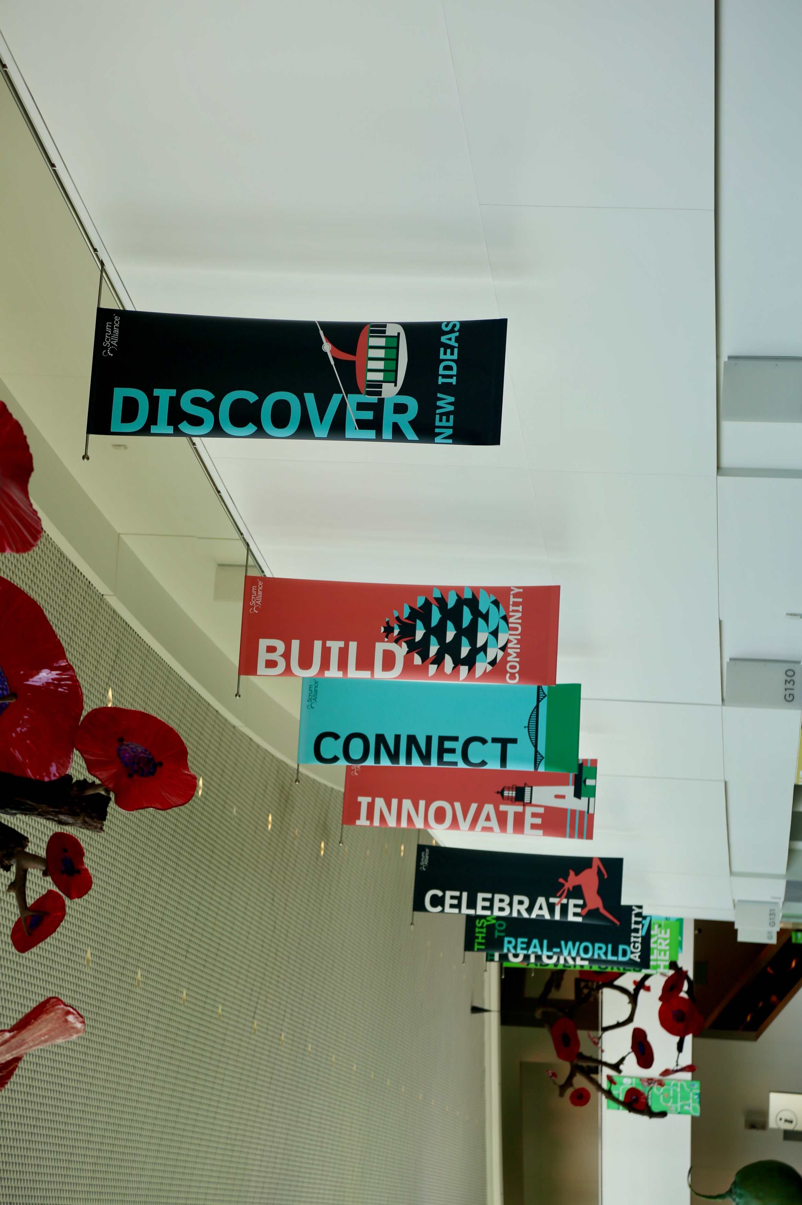
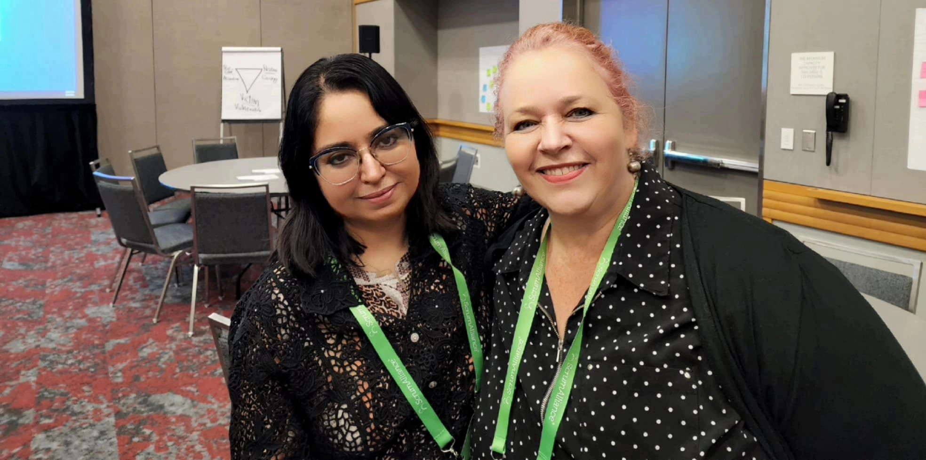
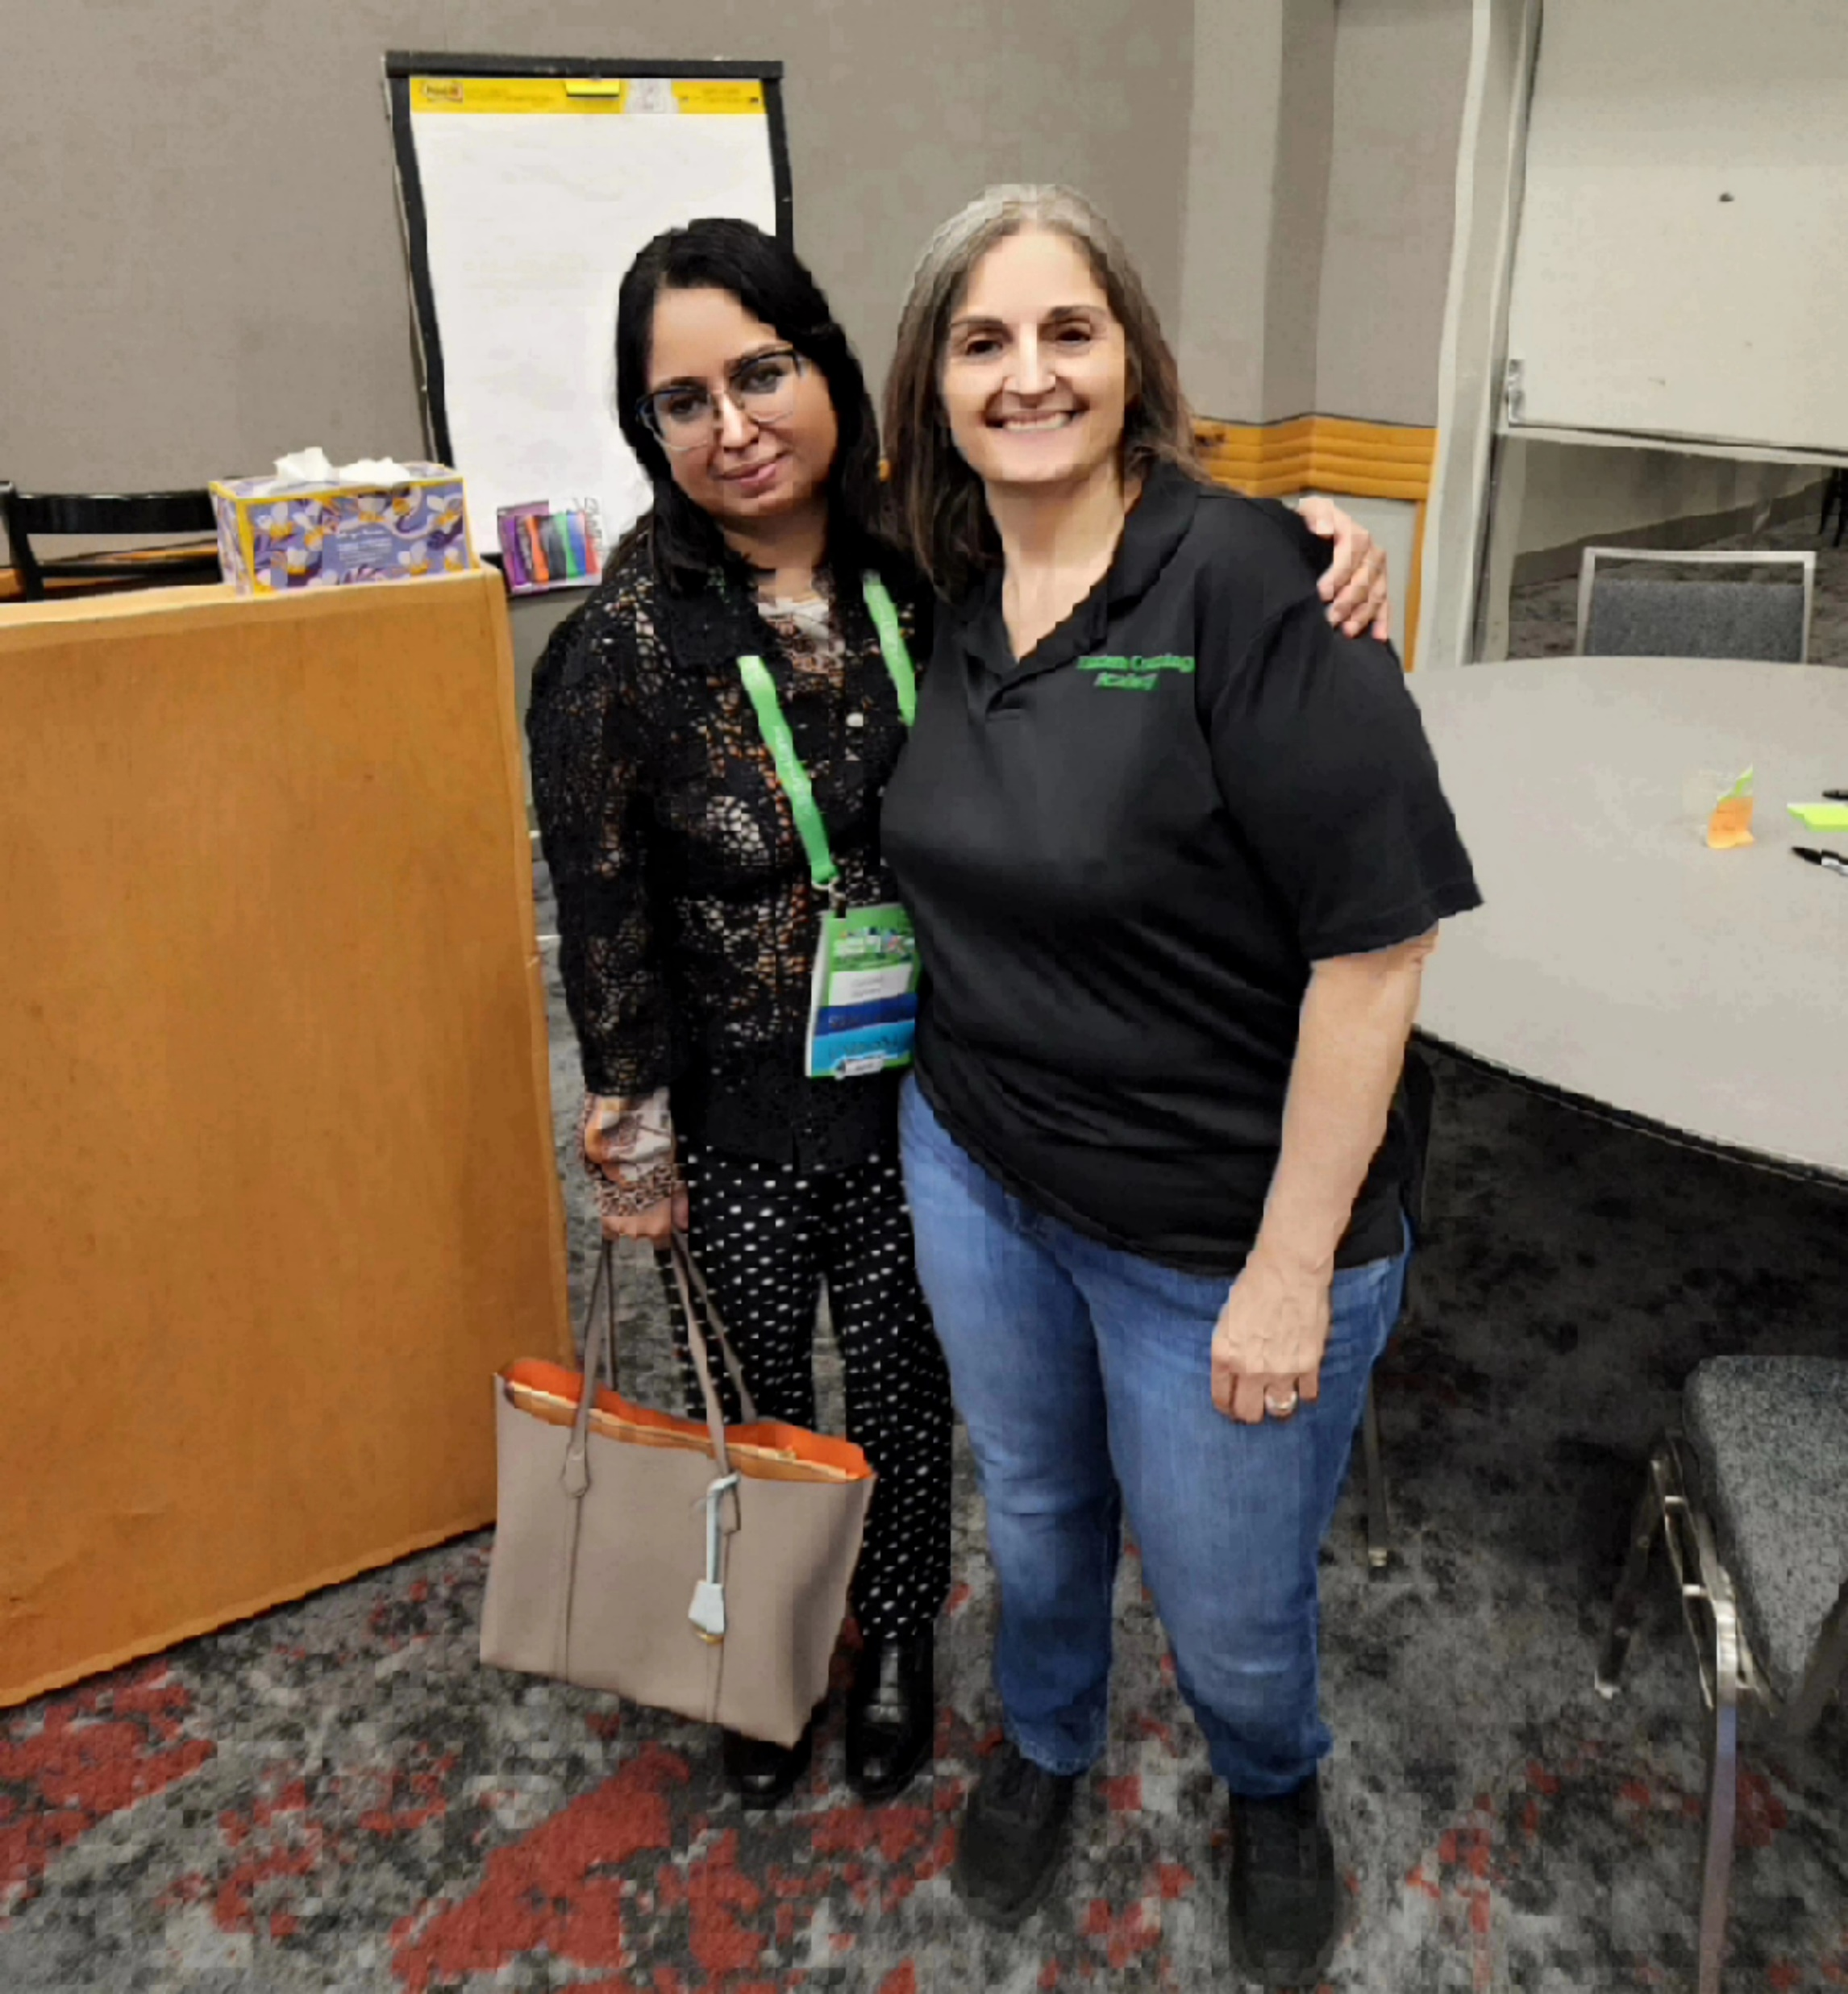
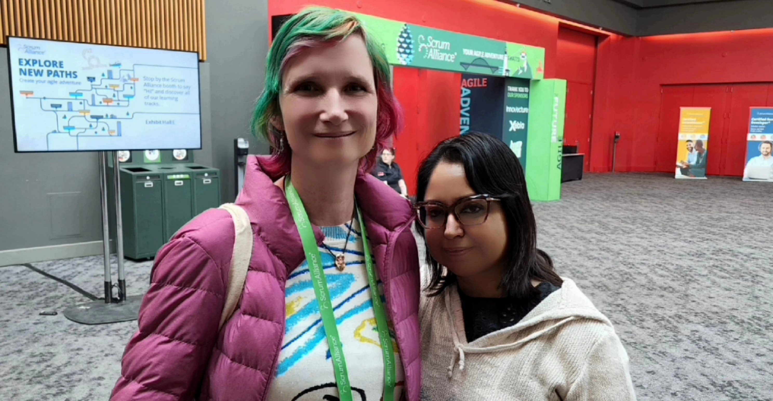
And Here’s AlicE …
And This is My Adventure with Agility …
Notes:
Alice is my avatar, as I reinvent myself through experiences and epiphanies, while moving the dial on agility in my sphere of influence across the portfolios. This has been such an immersive and profound adventure for me. One common thread throughout has been: staying anchored in Deep Curiosity. This is my superpower and I continue to amplify this to honor, celebrate and serve agility.

